Slide 1

Relationship, Sexual Health, and Parenthood (RSHP)

Slide 2
Farida Ali
Principal Teacher of Curriculum
Year Head S3 and S4
Contact details:
Email farida.ali@pilrigpark.edin.sch.uk
Phone 01317067960

Slide 3
Agenda for this session
Welcome
Key Rights, Laws and Guidance
Is Relationship, Sexual Health and Parenthood education needed?
What is Relationship, Sexual Health and Parenthood (RSHP) Curriculum
Relationship, Sexual Health and Parenthood Curriculum (RSHP) website/ resources
Relationship, Sexual Health and Parenthood (RSHP) Curriculum Q&A
Sticky notes for any questions/queries you may have

Slide 4

A national teaching and learning resource for Relationships, Sexual Health and Parenthood (RSHP) education
https://rshp.scot

Slide 5

Welcome
This PowerPoint details what we do in a part of our Health and Wellbeing curriculum that we call Relationships, Sexual Health and Parenthood (RSHP) education.
At Pilrig Park School we have decided to use a new national resource that you can see at https://rshp.scot/
The teaching of Relationship, Sexual Health and Parenthood(RSHP) has been in practice for some years, it is part of Curriculum for Excellence. This is a new resource, designed to help us to deliver the existing RSHP curriculum.

Slide 6

Key Rights, Laws and Guidance
Starter Question
Young people with disabilities have the same rights as non-disabled young people

Slide 7



Answer: Both! True and False
It is true Young people with additional needs have the same rights as young people without - ECHR & UNCRC (0-18yrs).
It is false as they also have additional rights – Convention on the Right of Persons with Disabilities(CRPD).
European Conventions on Human Rights (ECHR) and Human Right’s Act 1998
https://www.youtube.com/watch?v=pRGhrYmUjU4
United Convention on the Rights of Child(UNCRC)
https://www.youtube.com/watch?v=5KQGz-toMnk
United Convention on the Right of Persons with Disabilities(CRPD)
https://www.youtube.com/watch?v=St61pEPUuFw&t=1s

Slide 8

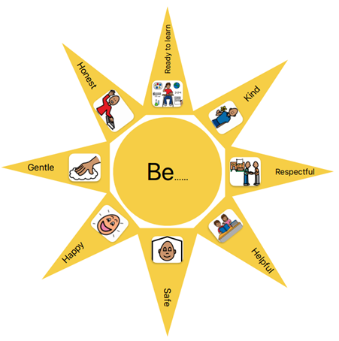
All children are entitled to Relationship, Sexual Health and Parenthood Education. This entitlement is preserved in the UN Convention on the Rights of the Child.
Article 3 – Best Interests
Article 13 – Freedom of Expression
Article 23 – Children with a disability
Article 24 – Health & Health Services
Article 28 – Right to Education
We are a UNICEF Silver Award Rights Respecting School where children’s rights are learned, understood and lived in this school
When planning the RSHP curriculum we looked at the following four core areas:
Personal care and hygiene
Relationships and sex education
Appropriate behaviour, including sexualized behaviour
Safeguarding
This is also embedded in our school values.
Which are: To be…
Kind, Respectful, Helpful, safe, Happy, Honest, Gentle and Ready to Learn.

Slide 9

Is RSHP education and support needed?
There are many misconceptions about why young people with additional needs or disabilities do not need:
RSHP education.
Support to have relationships.
Manage their sexual health.

Slide 10

Some common beliefs
Non-sexual beings
Infantilisation: the belief that people with disabilities, especially learning disabilities, or autistic people, are infant or childlike so do not experience sexual desire and have no need for romantic or sexual relationships
Asexuality: the belief that disabled people feel no romantic or sexual desires (note this is not actually what asexuality is).
Delayed/absent sexual development: these beliefs often stem from a misconception that disabled people do not experience the same sexual development as non-disabled people. They might believe that disabled people's sexual development happens much later, or never, so they have no sexual needs.

Slide 11

Some common beliefs cont…
Incapable/ Incapacity
The belief that disabled people will be physically or intellectually incapable of understanding or engaging in relationships or sex. A common belief is people with disabilities won't make good or safe choices about sex and relationships. Parenting is believed to be too complicated and that having any children would be at risk of harm
Protection from harm
the belief that people with disabilities will come to harm if they engage in relationships or sex - abuse, 'poor' choices, at risk of pregnancy or STIs, might get themselves in legal trouble etc. The best way to protect is to avoid talking about sex and relationships or allow disabled people to have relationships, sex or become parents
https://www.canva.com/design/DAE87eo-5aI/ncu1KjfbVqjEVqZxwb6r3Q/view?utm_content=DAE87eo-5aI&utm_campaign=designshare&utm_medium=link&utm_source=publishsharelink#3

Slide 12
So, how DO we protect young people?
By providing high quality, comprehensive RSHP education
Add a focus on building the skills needed to navigate sex and relationships
Provide accessible information about sex, consent, healthy relationships, where to get help, sexual health etc.
Normalise being positive about relationships and sex (at an appropriate age)
Assume people with additional needs are sexual beings who will have relationships and sex and will need support to manage their sexual health and wellbeing
Clearly create space for questions to be asked or issues to be raised
Make use of the relevant policies, procedures and legislation when there are concerns

Slide 13
What is RSHP Curriculum
Health and Well-Being is one of the 8 curricular areas in Curriculum for Excellence (CfE)
RSHP education is a key part of Health and Well-Being within Curriculum for Excellence.
Health and Well-Being curricular areas are designed to ensure children and young people develop the knowledge and understanding skills and capabilities which they need for their mental, emotional, social and physical well-being.
The learning in RSHP “ focuses on equipping young people with the knowledge, skills and values to make informed and positive choices about forming relationships helping them to make safer decisions about their sexual and emotional health and well-being in a responsible and healthy manner, as an important part of preparation for adult life.” (PSE: RELATIONSHIP AND SEXUAL HEALTH EDUCATION (RSHP) GUIDANCE FOR SCHOOLS NOVEMBER 2020)

Slide 14
What is the resource?
As a school we will be using the rshp.scot resource provided by Education Scotland to support teaching and learning.
All content is age and stage appropriate for learners 3-18 years, organised by Curriculum for Excellence Levels, from Early Level through to Senior Phase.
The resource has developed special content for Complex and ASN learners. It meets the needs of learners with additional support needs, including mild to moderate learning disabilities.
The resource has been developed by a working group including teachers, health professionals and government officers.

Slide 15
Why does RSHP matter?
https://vimeo.com/361263347

Slide 16
What will I find in the resource?
The rshp.scot resource is made up of a series of Activity Plans that describe how a teacher can approach an aspect of RSHP education.
The Activity Plans are supported by PowerPoints or other resources the lesson might need.
There is information for parents and carers, ideas about communicating between school and home, reading lists for school libraries and reading at home.
The rshp.scot resource is accessible and open to everyone; parents and carers can see what is being delivered in school.
The resource was developed by a partnership of Local Authorities and Health Boards, with advice from Education Scotland and Scottish Government.

Slide 17
Why has it been developed?
There is a need to improve the quality, relevance, consistency and coverage of RSHP education.
We need to deliver RSHP education that helps protect children and young people from harm and supports them to understand that friendships and personal relationships should be healthy, happy and safe.
The rshp.scot resource helps teachers to source material that is age and stage appropriate.
We need our RSHP education to reflect a modern and inclusive Scotland where we value and respect the human rights of everyone.

Slide 18
Is the RSHP resource age and stage appropriate?
https://vimeo.com/361994410

Slide 19
Curriculum for Excellence Levels
The Curriculum for Excellence is delivered progressively across 5 levels
  Early Level
  First Level
  Second Level
  Third and Fourth Level
  Senior Phase
  Pupils at our school are working from
  Pre-Early level
  Early level
  First Level
  Second Level
  The RSHP curriculum at Pilrig Park School will include resources for Complex ASN which is at Pre-Early Level

Slide 20
What do we do at Early Level?
When it comes to families and friendships, children learn:
That all our families are different, and that people who are important to the children provide care and love.
How to make and keep friendships, thinking about how they get along with other children, play together, co-operate and share. This can include learning about personal space and to recognise and respect how another person is feeling.
About the importance of kindness and showing kindness to others.
When it comes to every child being unique and special children learn:
That people are individual and unique.
About the similarities and differences among children in their group.
To understand that treating someone badly based on a difference is not okay.

Slide 21
What do we do at Early Level?
When it comes to their bodies, children learn about:
Names for parts of their body – and that parts of their body are private.
Keeping clean and why this is important – learning about hand washing and brushing teeth.
If you have questions regarding the body parts being definer further information can be accessed at the following link https://rshp.scot/faq/
When it comes to feelings and making choices children learn:
To recognise and express their feelings, including when they might feel safe or unsafe, happy or worried.
To identify adults that they can go to if they have a question or a worry, introducing the idea of trust.
When it comes to looking after them and other living things children learn about:
Where living things come from.
The needs of plants, animals and babies.
That there are professional people who help and care for them
Information for parents and carers about RSHP learning at Early Level at school and at home: https://rshp.scot/early-level/

Slide 22
What do we do at First Level?
When it comes to relationships children learn about:
What makes then unique
Families, and how all our families are different
The different adults who might care for children – like teachers, support staff in school
Making and having friends
Being a boy and a girl and that they can be any kind of boy or girl they want to be
What makes people alike and what makes us different (diversity)
Respect for others and the importance of being kind.
When it comes to growing up and their body children learn about:
Making choices and decisions
Looking after their body and keeping clean
How their bodies change as they grow
Names of parts of their body and names for private body parts; we use the words penis, vulva, bottom, nipples
If you have questions regarding the body parts being definer further information can be accessed at the following link https://rshp.scot/faq/
Parts of their body are private
Other people should not touch the private parts of their body
What behaviour is okay in public and what is okay in private.

Slide 23
What do we do at First Level?
When it comes to how human life begins, pregnancy and birth children learn about:
The life cycles of plants and animals
How a baby is made (conception)
Pregnancy and how a baby is born
What a baby needs and how to care for a baby.
Information for parents and carers about RSHP learning at First Level at school and at home: https://rshp.scot/first-level/

Slide 24
What do we do at Second Level?
When it comes to relationships children learn about:
What makes them unique and what makes people alike and what makes us different (diversity)
Making and having friends
Being a boy and a girl, and that they can be any kind of boy or girl they want to be
Loving relationships and being attracted to others
Respect for others and the importance of being kind – in our face-to-face relationships and online.
When it comes to being safe children learn about:
Social media and being safe and smart online
Feeling safe and unsafe
Different kinds of abuse and neglect that can happen to a child
What we mean by consent
Who they can go to for help and support.
If you have questions regarding any of the content covered in Second Level further information can be accessed at the following link https://rshp.scot/faq/

Slide 25
What do we do at Second Level?
When it comes to growing up and learning about their body children learn about:
Making choices and decisions
Looking after their body and keeping clean
Puberty and how the bodies and emotions of both girls and boys change as they grow
What ‘having sex’ is and about contraception and condoms.
When it comes to conception, pregnancy, birth and being a parent/carer children learn about:
How a baby is made (conception)
Pregnancy and how a baby is born
Being a parent and thinking about what kind of parent they would be.
Information for parents and carers about RSHP learning at Second Level at school and at home: https://rshp.scot/second-level/

Slide 26
What do children and young people want from their RSHP education?
https://vimeo.com/361997291

Slide 27
RSHP Curriculum plan
This is our first year delivering the RSHP curriculum at Pilrig Park School using the resources provided by Education Scotland.
The RSHP Curriculum mapping focuses on the 4 key themes for Curriculum for Excellence organisers within RSHP/Health and Wellbeing
Physical changes
Positive relationships
Sexual health and sexuality
Role of parent/carer
The levels of progression are:
Pre-early – Early Level
Early – First Level
First – Second Level
The content is derived from the 9 thematic units and from early to second level resources.

Slide 28
Curriculum levels and assessment
For early learning settings, in primary and secondary, complex ASN and college, RSHP resources, provided by Education Scotland provide learning activities
The learning activities covered for Complex ASN setting are at pre-early level
The resources for complex ASN settings have 9 thematic units:
My body
Puberty
Personal Hygiene
Gender
Relationships
Personal space and boundaries
Masturbation
Consent
Pregnancy and parenthood

Slide 29
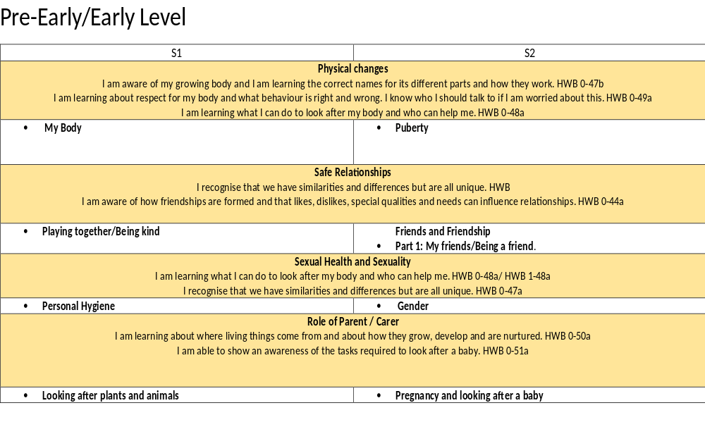
RSHP Curriculum Map
Published on the school website

Slide 30
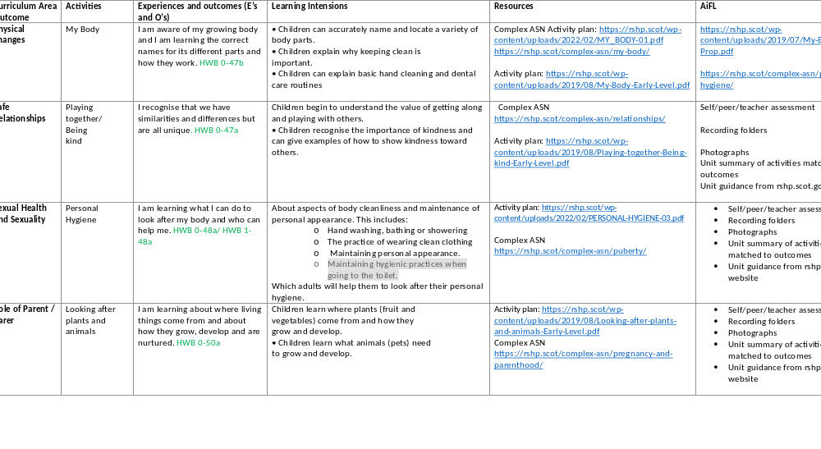
RSHP Curriculum Plan
Published on the school website

Slide 31

Below is the link to the RSHP Resource that we will be using at Pilrig Park School
https://rshp.scot

Slide 32
Parents and Carers
Across this resource, and in our school approach to RSHP education, there is an acknowledgement that parents and carers are the primary educators of their children.
In delivering RSHP education parents/carers will be given advance knowledge of topics and lessons.
By learning together at home and school we can help consolidate learning – it’s a partnership approach.
At Pilrig Park School we understand the importance of Parental Engagement in learning and hope that you will support us in the delivery of RSHP within our school.
We as a staff would be happy to discuss any questions or concerns around your child’s RSHP education.

Slide 33
What is the role of parents and carers in
RSHP education?
https://vimeo.com/361996285

Slide 34
If you have further questions about the RSHP resource the FAQ section on the site may be of help: https://rshp.scot/faq/
https://rshp.scot/

Slide 35
Relationship, Sexual Health and Parenthood Curriculum (RSHP)
We will be happy to take any questions or concerns you want to share about the RSHP curriculum.
We can take any questions on sticky notes
I am happy to discuss any issues after the meeting.

