Slide 1

Welcome to our
Senior Phase Information evening
Keith Mackay – DHT
Classes – Tweed, Clyde, Forth and Ness

Slide 2
Curriculum Rationale
New curriculum built around our classes
4 Senior Phase Classes in S4, S5 / S6 – Clyde, Forth, Ness and Tweed
S4 – Ness
S5- Forth
S6 – Tweed
S4 – S6 Clyde Class

Slide 3
Maths – 3
English – 3
Art – 1
P.E – 2
H.E – 2
Music- 2
Digital Skills - 1
SP Choices – 4
SQA Employability – 2
ASDAN PHSE – 2
ASDAN Personal Development – 2
SQA Personal Achievement – 2
Pupil Voice - 1
Clyde Class

Slide 4
Maths- 3
English – 3
Prince’s Trust Award – 2
Creative Arts – 2
ASDAN PHSE – 2
Music – 2
P.E – 2
H.E – 2
ASDAN Personal Development – 2
ICT – 2
SP Choices – 4
Pupil Voice – 1
Tutor Time - 1
Ness Class
S4

Slide 5
Maths- 3
English – 3
Prince’s Trust Award – 4
Roadwise - 2
ASDAN PHSE – 2
ASDAN Personal Development – 2
ICT – 1
SQA Mental Health Award - 1
SP Choices – 8
Pupil Voice – 1
Tutor Time - 1
Forth Class
S5

Slide 6
Maths- 3
English – 3
Prince’s Trust Award – 2
ASDAN PHSE – 2
ASDAN Personal Development Gold – 2
ADDAN Living Independently - 2
ICT – 1
SQA Mental Health Award - 1
SP Choices – 8
Mentoring - 2
Pupil Voice - 1
Tutor Time - 1
Tweed Class
S6

Slide 7


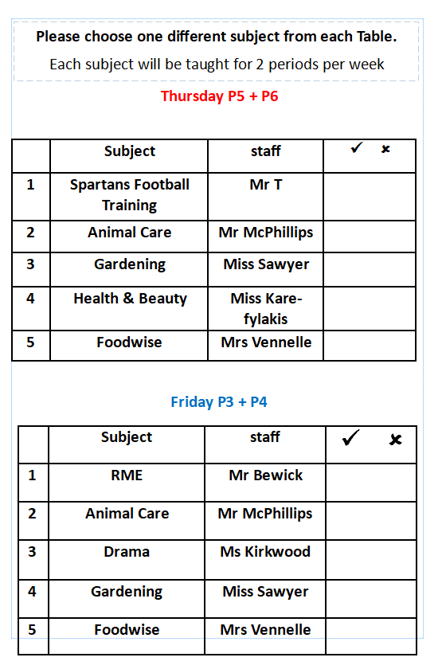
S5 & S6 subject choices
2023 – 2024

Slide 8
Post school planning and partnerships
S4 – S6, YPPPM – Young Person Planning Meeting – Annual, then more frequent as required in final year at school.
Support and Guidance Leanne McQuade
Development Officer – ASN Post School Transitions
YAD Team – Young Adult Disability Team
LAC Team - Local Area Co- Ordination Team
SDS – Skills Development Scotland, Careers Advisor
ENABLE WORKS
Edinburgh College – ACE , Access and Continuing Education Courses as well as SCP, Schools College Partnership school college links course
DYW – Developing the Young Workforce

Slide 9
Development Officer for ASN Post School Transitions
Leanne McQuade
leanne.mcquade@edinburgh.gov.uk

Slide 10
Working with…
Schools
Social Care Teams
Health Care Teams
Third sector services
(including Day Service providers (e.g. UpMo, Primecare etc), Further Education providers (e.g. Edinburgh College), Employability Service providers (e.g. Barnardos, Thistle YP etc.), Transition Support providers (e.g. Mindroom etc.)
…to help achieve consistent and joined up practice

Slide 11
Current notable work
Transition planning guides issued to schools (now online)
Attending YPPMs to help assist with transition planning as well as training sessions for school staff
Links and consultations with service providers for adaptions/expansion of post school service
Linking schools with third sector transition support while still in school
Parent Focus Group
(please email - leanne.mcquade@edinburgh.gov.uk)
Working closely with the Scottish Transitions Forum
Helping schools develop transition curricular and extra curricular opportunities
Working with Health Care Teams to support their own transition pathways

Slide 12
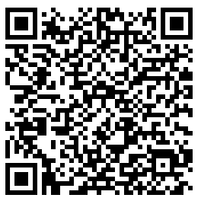
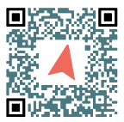
Notable Webpages
Parent/Carer Guide to Transition Compass Webtool

Slide 13

Careers Adviser
Skills Development Scotland
Paula Jack

Slide 14
My Role at Pilrig Park School
Careers Support offered to pupils at Pilrig Park school
One to one support.
Group session support
Attending young person planning meetings, for those leaving school.
Linking in with school staff and key partners to build a plan for next steps after school.

Slide 15




Career Management Skills

Slide 16

Steven Craig

Slide 17
Steven Craig
Curriculum Team Manager (acting)
Routes into Education or Employment team
Milton Road campus

Slide 18
Courses for young adults with additional support needs
Will usually have attended Special School provision, or had additional support for learning in mainstream school
Benefit from continuing to learn in a supported environment
Help transition to next phase of adult lives (e.g. until ready for mainstream course, employment or day-service provision)
Gain skills & qualifications to become more confident, independent learners

Slide 19
At school: 18 week Transition courses
Introduction to College (Schools College Partnership) senior phase pupils (S4-S6)
Sighthill & Milton Road campuses, two mornings or afternoons per week
Positive transition experience:
  pupils get to know us, the new surroundings, new classmates etc.
  and we get to know the pupils ☺
  two versions: SCQF level 1/2 and SCQF level 3/4

Slide 20
Post-school options: 36 week courses
Supported College Experience (SCQF Level 1)
Skills for Independence (SCQF Level 2)
Skills for College (SCQF Level 3)
Usually three days per week – 18hrs teaching
Supportive environment, with a range of subjects:
Literacy, Digital Skills, Number skills (time, measuring, money etc.) Planning an Event, Health & Wellbeing, Independent living skills, Personal Organisation; Environmental issues, John Muir award, Volunteering, Modern Studies

Slide 21
Post-school options cont’d
Skills for Life & Work (SCQF 4) – 18 weeks with work placement
Supported vocational courses (SCQF 3/4) – 18 weeks inc:
  Intro to Computing & Digital Media/Further Computing & Digital Media
  Routes into Care & Social Science
The team is comprised of highly skilled professionals with many years experience working with young adults with ASN

Slide 22
Thanks for listening!
steven.craig@edinburghcollege.ac.uk

Slide 23
Young Adult Disability Team
Jennifer Moir
Social Worker

Slide 24

Local Area Co-ordination Team
Walter Anderson | Depute Manager | Local Area Coordination Team

Slide 25


Slide 26


Stepping Up Support in Pilrig Park
Rebekah Hare
Employment Coordinator
Senior Phase Information Evening
07/09/2023

Slide 27




2,500 employees; Over 13,000 people supported; £65m income
  £51m income
  2,200 employees
  Over 1,100 people supported to live independently
  2.5m hours of social care support 27 local authority areas
  Sector-leading CI grades
  £12m income
  150 employees
  5500 people supported across 28 local authority areas per year
  1000 disabled people supported into work
  Over 2,000 employers supported to be inclusive
  £1.5m income
  30 employees
  12,000 members across 32 local authority areas
  Charitable projects supporting 3,000 people per year
  30 local branches supporting 2,000 people

Slide 28

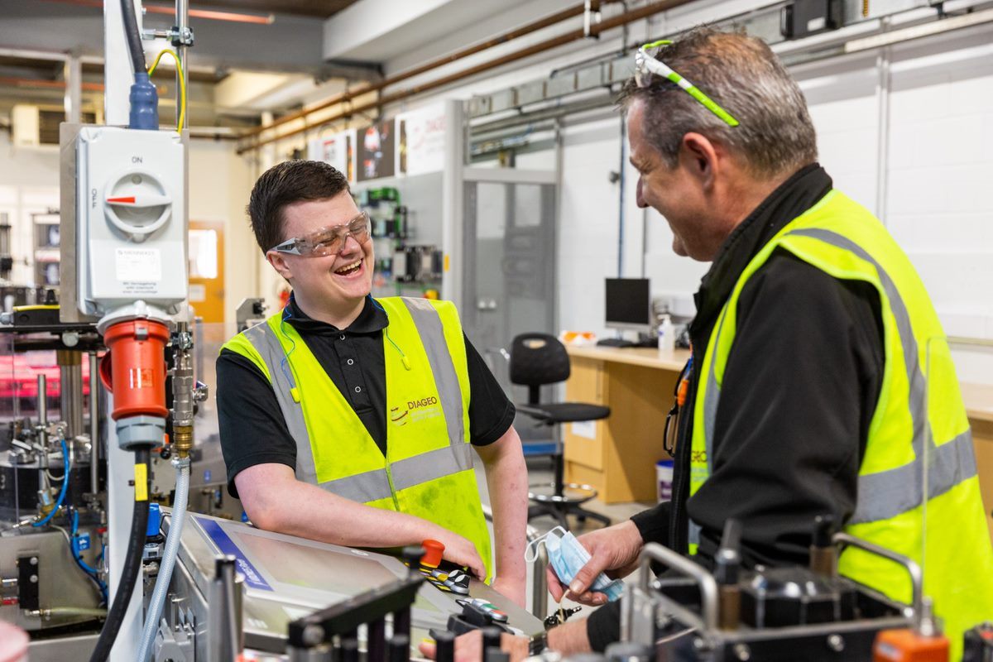
Enable Works
We believe that every person in Scotland has the
right to work in a job that is high quality
and well paid.
Enable Works supports over 5500 people every year
across 28 Scottish Local Authorities to learn skills for work and more than 1000 people into work.
We partner with thousands of employers to create inclusive cultures and improve the diversity of Scotland’s workforce.
Together we will challenge perceptions of disability and unleash the potential in Scotland's future workforce.

Slide 29




Why are we needed?
There are an estimated
9% of school leavers
175,000 people
who have a learning disability go into university , compared with
who have a learning disability in Scotland
45% of all school leavers
There is a significant disability employment gap
For every £1 a non disabled person makes,
a disabled person
50% of disabled people
are in employment in Scotland, compared with
earns just 83p
82% of non-disabled people

Slide 30
What is the Stepping Up Programme and how do we deliver it in Pilrig Park?

Slide 31



Programme Structure
Who?
When?
What?
Vocational Profile
Practical Employability Skills
Employer Engagement

Slide 32
Programme Structure
CV Building
Travel Training
Work Experience
Community Impact
Interview Training
Work Tasters

Slide 33




Thank you
Questions?
@Enable_Tweets
/enablescotland
/enablefacebook
@enable_updates

Slide 34

Developing the Young Workforce
Elizabeth Hazley elizabeth.hazley@edinburghchamber.co.uk

Slide 35

​
Connecting employers with young people and education

Slide 36

​
Employability Skills / Programmes
Transition Events
Workplace Visits
Projects
Workshops

Slide 37

Wednesday 4th October
09:30 – 12:30
Baron Suite of O2 Academy Edinburgh
Parents and Carers are very welcome!

Slide 38


Thank You
elizabeth.hazley@edinburghchamber.co.uk

Slide 39
Questions Welcomed.

