Slide 1
ARTICLE OF THE WEEK

Slide 2
INSTRUCTIONS
Slide 3: Guess the article
Slide 4: Introducing Article 42
Slide 5: Exploring Article 42
Slide 6: Some possible answers
Slide 7 & 8: Primary activities
Slide 9, 10 & 11: Secondary activities
Slide 12: Reflection

Slide 3

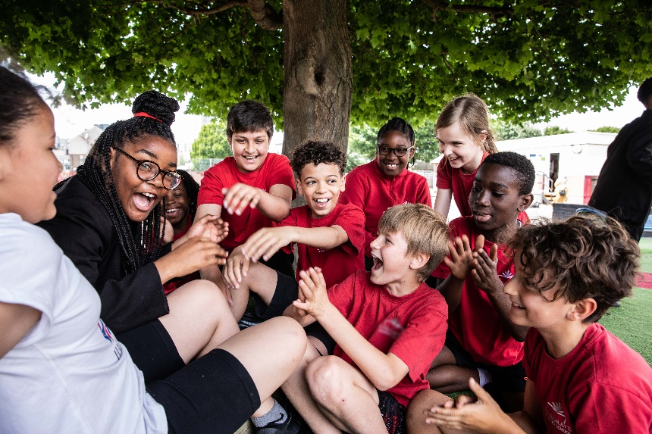
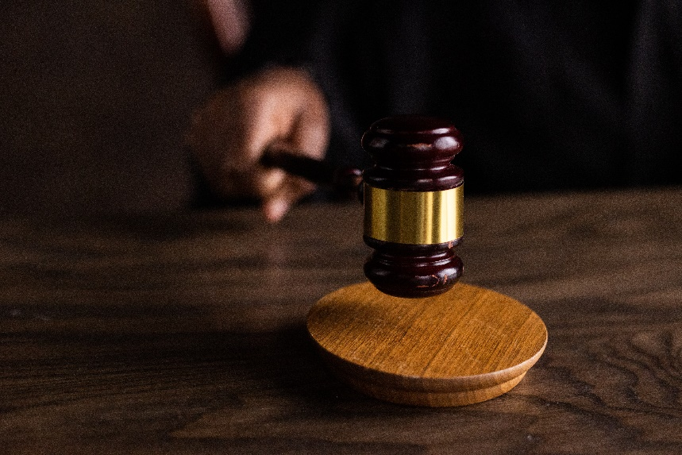
GUESS THE ARTICLE
@ Freepik
@ UNICEF/ Dawe
@ Pexels
These pictures provide a clue to this week’s articles.
How do these pictures help you? Can you guess how they are linked together?
Write down your thoughts or discuss with someone in your class.

Slide 4
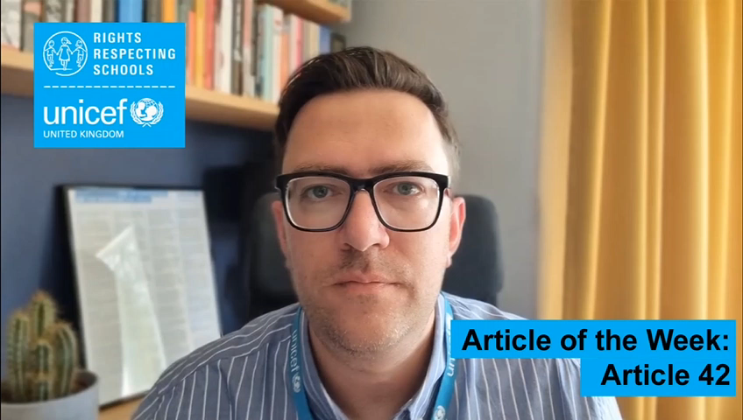
INTRODUCING ARTICLE 42
Steven Kidd, RRSA Professional Adviser, introduces Article 42
Article 42 – knowledge of rights
Governments must actively work to make sure children and adults know about the Convention.
The Scottish Parliament has unanimously agreed to incorporate the UNCRC into Scots Law. When this happens, decision-makers MUST take rights into account and children will then be able to challenge decisions in court if they feel rights are denied. The Bill is a milestone on Scotland’s journey towards making rights real for every child.
Click here to watch on YouTube

Slide 5
EXPLORING ARTICLE 42
Why is it important that everyone knows about children’s rights and takes them seriously?
Have a think and write down some answers.

Slide 6
EXPLORING ARTICLE 42
Did you think of these?
Rights are for every child – so every child and young person should know that they have them.
Rights are there to protect and safeguard children.
It should feel ‘normal’ for people to know that children have rights.
If you know about your rights, then you are more able to claim them and to speak out if your rights are not being met.
When adults know about rights, they can act to respect them.
Duty bearers need to know that it is their responsibility to ensure that all children and young people can access all their rights.
Children are empowered. Their views and voices should be listened to and respected.
If everyone knows about and respects rights, decision-makers are more likely to listen to children and make changes to improve all aspects of their lives.
Article 42 says that governments must tell everyone about children’s rights.
What else did you think of?

Slide 7

PRIMARY ACTIVITIES
You do not need to complete every activity but if you have time, you can try to complete more than one.
Have you heard of the Children’s Commissioner? What do you think their job is? Do a bit of research and find out five facts about Scotland’s Commissioner for Children and Young People. Share these with the rest of your class and family at home.
For the youngest children, use this video as a reminder about their rights. Lead into a discussion about the rights they enjoy every day in school and introduce a simple explanation that Scottish Government has committed to protect their rights in law.
What makes a good duty bearer? Identify the knowledge, attitude, and skills you think would ensure that adults can facilitate your access to rights. Write a list of ideas to discuss with duty bearers in your school. (For the youngest children – explore the role of trusted adults in your lives – who are these people and why are they important?)
Governments and schools have to make sure that everyone is able to learn about rights. Some children find it easier to understand pictures, so some of the UK’s Children’s Commissioners have created these symbols representing each of the articles of the CRC. Look through them with a partner and decide, in your opinion, which symbols represent the article the best. Discuss with the rest of your class.

Slide 8
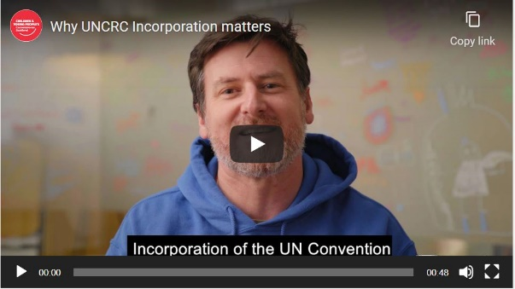
PRIMARY ACTIVITIES 2
You do not need to complete every activity but if you have time, you can try to complete more than one.
Download a copy of the CRC summary and try to identify as many ways school helps you to enjoy your rights as you can. Sort the articles into groups, to show which rights you enjoy in school and which ones your school could do more to protect and promote. How could you be involved more in some of these improvements needed?
The Scottish Government is providing funding for RRSA in Scotland for the next three years – what would you like to see happen over that time? How do you think RRSA could be better? Gather ideas from your class, pupil council or other group and share them with us at rrsa@unicef.org.uk. We would love to hear from you. You can also think about how you could encourage other schools in your area to sign up for RRSA so all children in Scotland know their rights.
The Scottish Parliament has unanimously agreed to incorporate the CRC into Scots Law. Watch this video from the Children and Young People’s Commissioner Scotland to see why it’s so important. What’s the latest situation on incorporation? More information here that may help you.
Are rights visible in your school? Can you see them on the walls, in lessons, and assemblies? What about the website or on social media? How can you make sure that everyone knows your school is a Rights Respecting School?

Slide 9
SECONDARY ACTIVITIES
You do not need to complete every activity but if you have time, you can try to complete more than one.
Have you heard of the Children’s Commissioner? What do you think their job is? Do a bit of research and find out five facts about Scotland’s Commissioner for Children and Young People. Share these with the rest of your class and family at home.
Governments and schools have to make sure that everyone is able to learn about rights. Some children find it easier to understand pictures, so some of the UK’s Children’s Commissioners have created these symbols representing each of the articles of the CRC. Look through them with a partner and decide, in your opinion, which symbols represent the article the best. Discuss with the rest of your class.
The Scottish Parliament has unanimously agreed to incorporate the CRC into Scots Law. Watch this video from the Children and Young People’s Commissioner Scotland to see why it’s so important. What’s the latest situation on incorporation? Research reliable news sources to find out.
The Scottish Youth Parliament is the democratically elected voice of young people in Scotland. Find out about their work and their campaigns. If your school is not already involved, prepare a proposal for your pupil council to promote the Youth Parliament in your school.

Slide 10

SECONDARY ACTIVITIES 2
You do not need to complete every activity but if you have time, you can try to complete more than one.
Watch this Poyum for Rights by Scots author Lenniesaurus. What do you think? Could you write your own poem celebrating the importance of rights, in Scots, English or another language you know?
What makes a good duty bearer? Identify the knowledge, attitude and skills you think would ensure that adults can facilitate your access to rights. Write a list of ideas to discuss with duty bearers in your school.
Download a copy of the CRC summary and try to identify as many ways school helps you to enjoy your rights as you can. Sort the articles into groups, to show which rights you enjoy in school and which ones your school could do more to protect and promote. How could you be involved more in some of these improvements needed?
The Scottish Government is providing funding for RRSA in Scotland for the next three years – what would you like to see happen over that time? How do you think RRSA could be better? Gather ideas from your class, pupil council or other group and share them with us at rrsa@unicef.org.uk. We would love to hear from you. You can also think about how you could encourage other schools in your area to sign up for RRSA so all children in Scotland know their rights.

Slide 11
SECONDARY ACTIVITIES 3
You do not need to complete every activity but if you have time, you can try to complete more than one.
The Young Scot website provides accurate and appropriate information in a world full of fake news, helping you to enjoy all of your rights safely. Pick one of the articles on their site and share a top tip from what you learn.
Are rights visible in your school? Can you see them on the walls, in lessons, and assemblies? What about the website or on social media?
How can you make sure that everyone knows your school is supporting children’s rights?
Article 42 is all about spreading the word on children’s rights. It’s the responsibility of Government, but you can do your bit! Create your own marketing campaign to encourage people to learn more about the CRC – you could make posters, think up slogans, even make a video advertisement.
Research a news event that is happening right now and affecting children’s rights – this can be either in your local area or globally. What barriers are stopping children and young people from accessing rights? What is their government doing (or not doing) to ensure they know and are able to enjoy their rights?

Slide 12
REFLECTION
Give yourself some time and try to find a space where you can be quiet and think…
How does it make you feel to know that Scotland will incorporate children’s rights into domestic law?
Not many countries have done this.
Why do you think it is important?
How might it make life better for children and young people across Scotland?
What could you do to make sure more people know about it?

Slide 13

MORE INFO
RRSA WEBSITE
For more information or to download previous Article of the Week packs please visit the RRSA website by clicking on the link below.
CLICK HERE

Slide 14
THANK YOU

