Slide 1
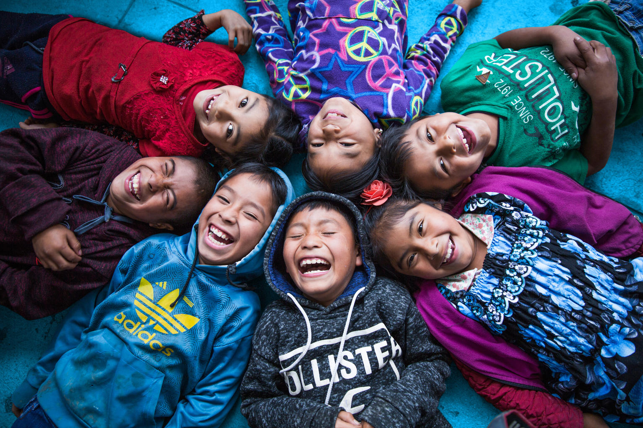
UNICEF/UNI328446

Slide 2
Slide 3 – Guess the article
Slide 4 – Introducing Article 15
Slide 5 – Exploring Article 15
Slide 6 – Some possible answers
Slides 7&8 – Primary Activities
Slides 9&10 – Secondary Activities
Slide 11 – Reflection

Slide 3
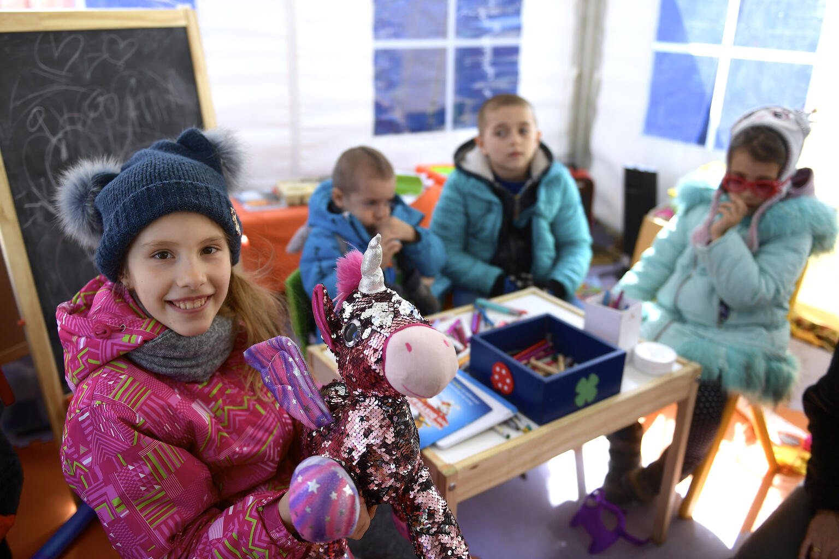
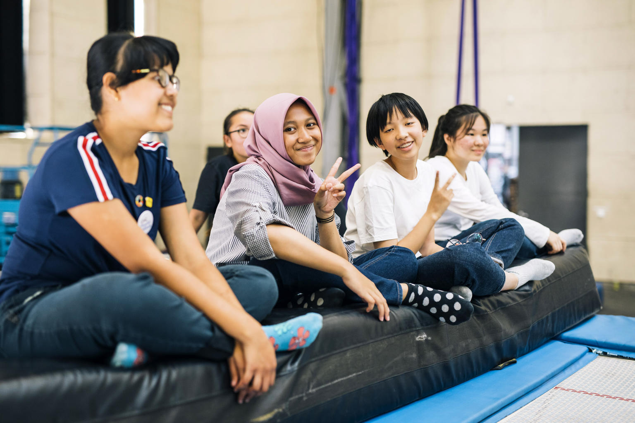
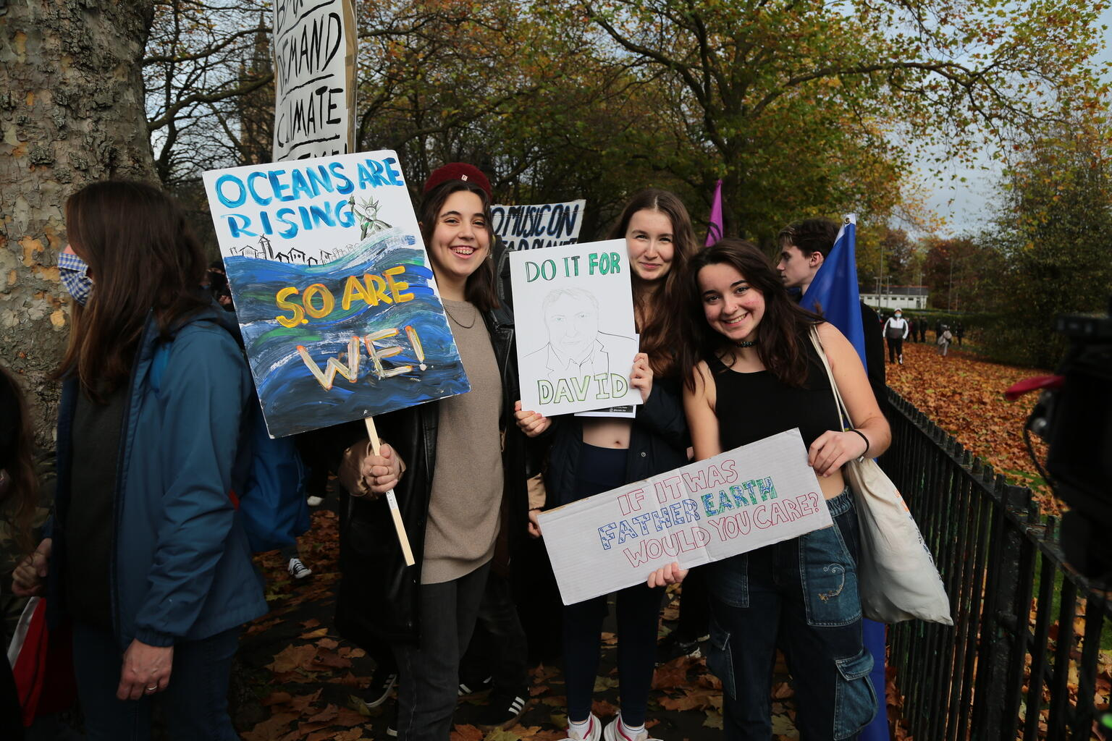
Guess the Article
These pictures provide a clue to this week’s article.
How do these pictures help you? Can you guess how they are linked together?
Write down your thoughts or discuss with someone in your class.
@UNICEF/Alex Nicodim
@UNICEF/ Marcel Wogram
@UNICEF/ Howard Elwyn-Jones

Slide 4
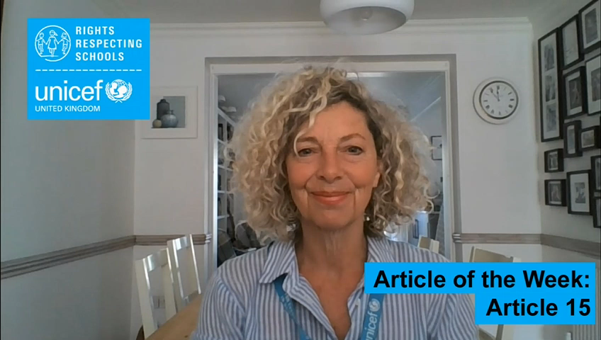

INTRODUCING ARTICLE 15
Jilly Hillier, RRSA Professional Adviser, introduces Article 15
Article 15 (freedom of association):
Every child has the right to meet with other children and to join groups and organisations, as long as this does not stop other people from enjoying their rights.
Click here to watch on YouTube

Slide 5
EXPLORING ARTICLE 15
Why is important that young people should have the opportunity to meet, spend time together and share ideas?

Slide 6
Did you think of these?
Young people have a right to participate and to be listened to and be heard.
We can learn a lot from other children and young people that helps to form our views and opinions about different things.
Meeting others helps us learn and develop new skills: how to resolve issues, find ways to compromise, share, encourage, show support and empathy.
By being with other people, we learn more about ourselves.
Joining groups or organisations can help us learn more about different issues.
People can be stronger together. Joining together as a group, we can bring about change.
It can be good for our mental health and wellbeing.
What else did you think of?

Slide 7

Share some memories of going to your first nursery or playgroup. Can you remember what it was like? How did you feel? What did you enjoy most? Talk to a partner to come up with ways you would help new children coming to nursery for the first time.
The story called The Invisible Boy is about a boy who doesn’t feel he fits in with others at school. It is read aloud here. Think about what rights of Brian are being affected and how he might be feeling. Talk to some friends about what you would do in his situation. Or how you would treat someone who is a bit different in your school.
Imagine you are meeting others in a new club. What would you tell them about yourself? What would you like to know about them? Design a ‘personal profile’. What sort of things do you like to find out when you meet somebody new?
Work together to make a short video that could go on your school’s website to show any new pupils and families the range and purpose of the pupil groups in your school. Link it to Articles 15 and 12. Make it clear what the groups do, how to join and what positive changes they have made and could make.

Slide 8

If you belong to a few different clubs and/or groups, what's the difference between them? Are some just for fun? Do others help you to learn a new skill? Do others help you to make a difference or change something in your school or local community?
Think about what adults can do to help you enjoy your right to association. Not just teachers or parents, but think about all duty bearers in the wider community. What can you do to claim your right, relating to Article 15? Perhaps create two separate columns to capture your ideas for what adults as duty bearers can do and you as the rights holders can do.
It is a common misunderstanding that Article 15 means ‘children have the right to friends’. Can you try to explain it differently - perhaps a more catchy way to help others remember what it means more accurately? It might help to research the meaning of ‘freedom of association’.
Think about a group or club you are part of.
Create a poster, leaflet, video or content for an adult to send as a social media post to encourage other people to join it. Make sure to list all of the reasons why it is a good idea to join this group and why you love it so much. Can you link your club to any rights?

Slide 9
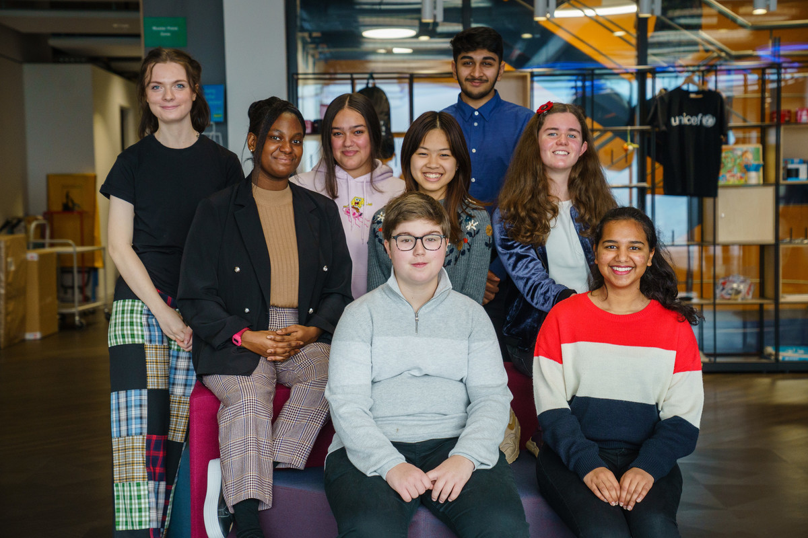
What are the most popular groups that children and young people are involved in outside of school? Devise a questionnaire to help you understand how young people spend their time outside of school. Perhaps you could invite students to talk about the benefits of their involvement in their particular group in tutor time or in assembly.
UNICEF’s Youth Advisory Board (YAB) is a group of young people who come together to help UNICEF UK understand what children and young people are interested in and what they care about in the world. You can find out more here. Imagine you were applying to be part of the YAB. What would you say about yourself and the issues you are interested in?
It is a common misunderstanding that Article 15 means ‘children have the right to friends’. Can you try to explain it differently - perhaps a more catchy way to help others remember what it means more accurately? It might help to research the meaning of ‘freedom of association’.
Work together to make a short video that could go on your school’s website to show any new pupils or families the range and purpose of the pupil groups in your school. Link it to Articles 15 and 12. Make it clear what the groups do, how to join and what positive changes they have made and could make.

Slide 10
The Article 15 Project supports child-led groups and movements. Their video Child Movement in Nepal shares how young people coming together had a huge impact. Take notes of the benefits as you watch the video. If you could create an Article 15 style project that links with your school and local community, what would your focus be?
The full text of Article 15 talks about the freedom “of peaceful assembly”. What do you understand this to mean? Have you seen examples in the news when groups meet together perhaps in a way that threatens other people or makes them feel annoyed? What are your thoughts about this?
An important part of Article 15 is children’s right to join groups ‘as long as this does not stop other people from enjoying their rights.’
Discuss with a friend what you think this means in practice in school or beyond the school gates. Sometimes, when certain kinds of ‘gangs’ meet they can threaten other people’s rights. The NSPCC has information and advice about involvement in gangs and what support is available for children and young people. You can find out more here. How could you share this information in school?
Find out about ‘mosquito’ devices, sometimes used to stop young people gathering together in public places. In 2016, the UN Committee on the Rights of the Child called on the UK to ban their use. What do you think about this? Discuss which other rights are affected? Find some info here about the work of the Children’s Commissioner in Scotland on mosquito devices.

Slide 11
REFLECTION
Take some time alone…
to think about time with others!
Why is it good to meet up?
What’s important about belonging?
How can you help to make others feel that they are welcome and really belong to groups you are part of?
How can you show appreciation for what others bring to groups you are in?
Who are the duty bearers who help to make your groups happen? How could you thank them?
UNICEF UK/Dawe

Slide 12

MORE INFO…
RRSA WEBSITE
For more information or to download previous Article of the Week packs please visit the RRSA website by clicking the link below
CLICK HERE

Slide 13
Thank you
UNICEF UK/Dawe
Notes:
UNICEF UK/Dawe

