Slide 1
ARTICLE OF THE WEEK
UNICEF/Bseiso
Notes:
Image: Rahaf, 20, from Salt in Jordon, is a Youth Climate Leader with the UNICEF-supported Sawn (‘to protect/preserve’ in Arabic) programme.

Slide 2
INSTRUCTIONS
Slide 3: Introducing International Women’s Day
Slide 4 & 5: Exploring International Women’s day- Question and Answers
Slide 6, 7 & 8: Primary activities
Slide 9, 10 & 11: Secondary activities
Slide 12: Reflection

Slide 3
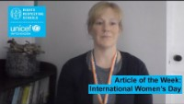

INTERNATIONAL WOMEN’S DAY
International Women's Day (IWD) is celebrated on 8 March. It is a global day celebrating the social, economic, cultural and political achievements of women. The day also marks a call to action for accelerating gender parity. Significant activity is witnessed worldwide as groups come together to celebrate women's achievements or rally for women's equality.
c
Kathy Allen, RRSA Senior Professional Adviser,
Introduces International Women's Day.
Article 2 – Non-discrimination
The Convention applies to every child without discrimination.
Click here to watch on YouTube

Slide 4
EXPLORING INTERNATINAL WOMEN’S DAY
Why do you think it is important to have a special day to celebrate women?
Have a think and write down some answers.

Slide 5
EXPLORING INTERNATIONAL WOMEN’S DAY
Did you think of these?
To celebrate how amazing women are.
To recognise how women have changed the world.
To acknowledge the challenges women still face around the world.
To encourage women to be themselves – to be the best they can be!
To let women know they are appreciated.
To speak out about inequality.
Fewer girls than boys go to school – this isn’t right.
Women often get paid less than men for doing the same job.
It is about equality and ensuring all are treated fairly and not discriminated against.
To explore what we need to do to create a world where gender equality exists.
Did you have any others on your list?

Slide 6
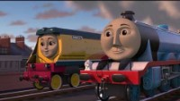
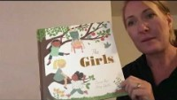
PRIMARY ACTIVITIES
You do not need to complete every activity but if you have time, you can try to complete more than one.
Watch Thomas and Friends on Gender Equality. Thomas talks about what his friends are good at and says that girls and boys should work as equals and have the same chances in life. What are you really good at? Share this with your friends. Can girls and boys be good at the same things?
Draw a picture of a woman or girl that you look up to. This might be a member of your family, someone at school or someone you have learned about. Share your picture with your classmates.
Have a boogie to celebrate International Women’s Day and dance along to songs which celebrate women. Make sure to use radio edits!
Choose a picture book for story time that features strong, independent girl characters, such as The Girls by Lauren Ace that tells the story of four very different girls and their strong bond of friendship. There is a great list of other suggestions from CLPE.

Slide 7
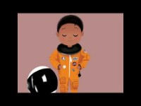

PRIMARY ACTIVITIES 2
You do not need to complete every activity but if you have time, you can try to complete more than one.
There are so many amazing women to learn about and some brilliant books that help you to do this! Watch this clip to see some drawings of the women who are part of the Puffin Little Leaders books. Choose someone to find out more about as a class.
Have you heard of the UN Global Goals? One of them is about gender equality. Find out more about Global Goal 5 by watching this video. What can you do to support the Global Goal of Gender Equality? Choose an action you will take individually or as a class.
Find out about some influential women who have changed the world in the ‘Fantastically Great Women’ series by Kate Pankhurst. You can see an extract here. Why not sing along to some of the songs from the musical based on the book. You could even try to write your own song about a woman who inspires you.
Discuss different jobs that people do. Can anyone do any job they like? Share your opinions in class. Watch this video and see if anything surprises you. What are your thoughts after watching the video? Draw a picture of you doing your dream job.

Slide 8
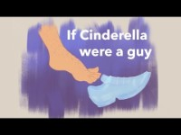
PRIMARY ACTIVITIES 3
You do not need to complete every activity but if you have time, you can try to complete more than one.
Watch ‘If Cinderella were a guy…’* Write your own fairy tale where ‘traditional’ gender roles are reversed or use other fairy tales that you know and change the characters around.
*The second part of the short video is promoting a book but raises some interesting questions.
Sadly, many girls across the world are unable to access the same education as boys. Imagine you were a girl kept at home to grow food, cook and help look after your siblings while your brothers went off to school each day. Write a poem about your feelings or a letter to your parents to explain why this situation should change.
Have you ever heard the word misogyny? As a class discuss its meaning. Unfortunately, there is still a great deal of hate directed towards women and girls, particularly on social media. To explore this as a class, check out this lesson Tackling online misogyny: mutual respect between boys and girls.
Article 2 is about non-discrimination. What does discrimination mean? Think about ways in which your school can be made fairer, and more equitable for girls (and boys). For example, think about your playground and whether there are spaces that both boys and girls enjoy. Present your ideas in a mind map and compare with friends. You might want to share the most popular ideas with senior leaders.

Slide 9
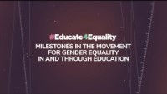
SECONDARY ACTIVITIES
You do not need to complete every activity but if you have time, you can try to complete more than one.
Take a look at the theme of International Women’s Day for this year. How can you get involved in celebrating women and promoting gender equality? Share your action on your school’s social media.
Around the world, 129 million girls are out of school and only 49% of countries have achieved gender parity in primary education. Watch Educate4Equality and write no more than three sentences about why you think equal education for girls is important.
Research an influential woman from today or from the past. Write a quiz about their life and achievements and share with your classmates.
Watch ‘If Cinderella were a guy…’* Write your own fairy tale where ‘traditional’ gender roles are reversed or use other fairy tales that you know and change the characters around.
*The second part of the short video is promoting a book but raises some interesting questions.

Slide 10
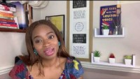
SECONDARY ACTIVITIES 2
You do not need to complete every activity but if you have time, you can try to complete more than one.
Sustainable Development Goal 5 is all about Gender Equality. Look at page 5 of this comic which shows what we can do to tackle gender equality. Work in groups to create your own comic showing four things you can do to work towards gender equality in your school or community.
Look at UNICEF’s Teen-Girl-Activist page and read about five inspiring young women from across the world. Choose an activist and decide what questions you would you ask if she came to visit your school.
Watch Abi Dare talk about her book ‘The Girl with the Louding Voice’. In the book the mother says “Your schooling is your voice child. It will be speaking for you even if you didn’t open your mouth to talk.” What do you think this means? Do you think it’s true for you?
Watch a Global History of Women’s Rights. In pairs or small groups, think of ways that the UK government can make the world a better place for women and girls of all nationalities. Present your ideas as a mind map.

Slide 11
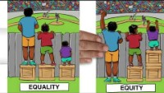
SECONDARY ACTIVITIES 3
You do not need to complete every activity but if you have time, you can try to complete more than one.
Article 2 is about non-discrimination. Think about ways in which your school can be made fairer, and more equitable for people of all genders. For example, think about spaces such as the playground, access to sports and clubs and uniform requirements. Present your ideas in a mind map and compare with friends. You might want to share the most popular ideas with senior leaders.
Have you heard the word misogyny being used? As a class, discuss what the word means and if you can think of any real-life examples of misogyny. Unfortunately, there is still a great deal of hate directed towards women and girls, particularly on social media. To explore this as a class, check out this lesson Tackling online misogyny: Misogyny, hate speech and toxic masculinity (secondary)
What is the difference between equality and equity? Watch this video to explore this question. How can we work towards gender equity as a school, and as a local, national and global community?
Choose 5 countries from around the world and use UNICEF’s 2021 State of the World’s Children data to compare primary and upper secondary completion rates for girls and boys. This can be found in Table 11 at the back of the report. Display your findings in a creative way.

Slide 12
REFLECTION
We need to be brave to challenge unfairness and make the world a better place for everyone.
Think of a change that would help to make a fairer world where gender equality is a reality. It might be something small.
Is there something you can do to make this happen?
Can you tell somebody about the change you would like to see?

Slide 13
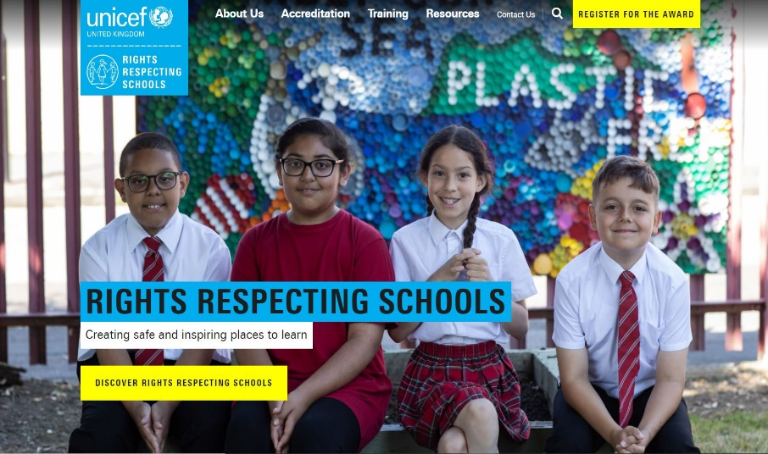
MORE INFO
RRSA WEBSITE
For more information or to download previous Article of the Week packs please visit the RRSA website by clicking on the link below.
CLICK HERE

