Slide 1
ARTICLE OF THE WEEK
UNICEF/Singhc
Notes:
Image: Children read children's reading book inside the community library at Majhgawan village, Gaurela-Pendra- Marwahi (GPM) district, Chattisgarh, India.

Slide 2
INSTRUCTIONS
Slide 3: Introducing World Book Day
Slide 4 & 5: Exploring World Book Day - Question and Answers
Slide 6, 7 & 8: Primary activities
Slide 9, 10 & 11: Secondary activities
Slide 12: Reflection

Slide 3

WORLD BOOK DAY
World Book Day was created by UNESCO on 23 April 1995 as a worldwide celebration of books and reading.
In countries around the world it is celebrated on the anniversary of that date, but in the UK it is generally marked on the first Thursday of March.
Spending just 10 minutes a day reading and sharing stories can make a crucial difference to your future success and is fun for all involved.
That’s why World Book Day continues to encourage children and young people to read for pleasure through its work with authors, illustrators, publishers, bookshops and libraries.
Helen Trivers, RRSA Senior Professional Adviser,
introduces World Book Day
Click here to watch on YouTube

Slide 4



LINKED ARTICLES
This week’s activities link to the following articles:
Article 17 (access to information from the media) - Every child has the right to reliable information from a variety of sources, and governments should encourage the media to provide information that children can understand. Governments must help protect children from materials that could harm them.
Article 29 (goals of education) - Education must develop every child’s personality, talents and abilities to the full. It must encourage the child’s respect for human rights, as well as respect for their parents, their own and other cultures and the environment.
Article 31 (leisure, play and culture) - Every child has the right to relax, play and take part in a wide range of cultural and artistic activities.

Slide 5
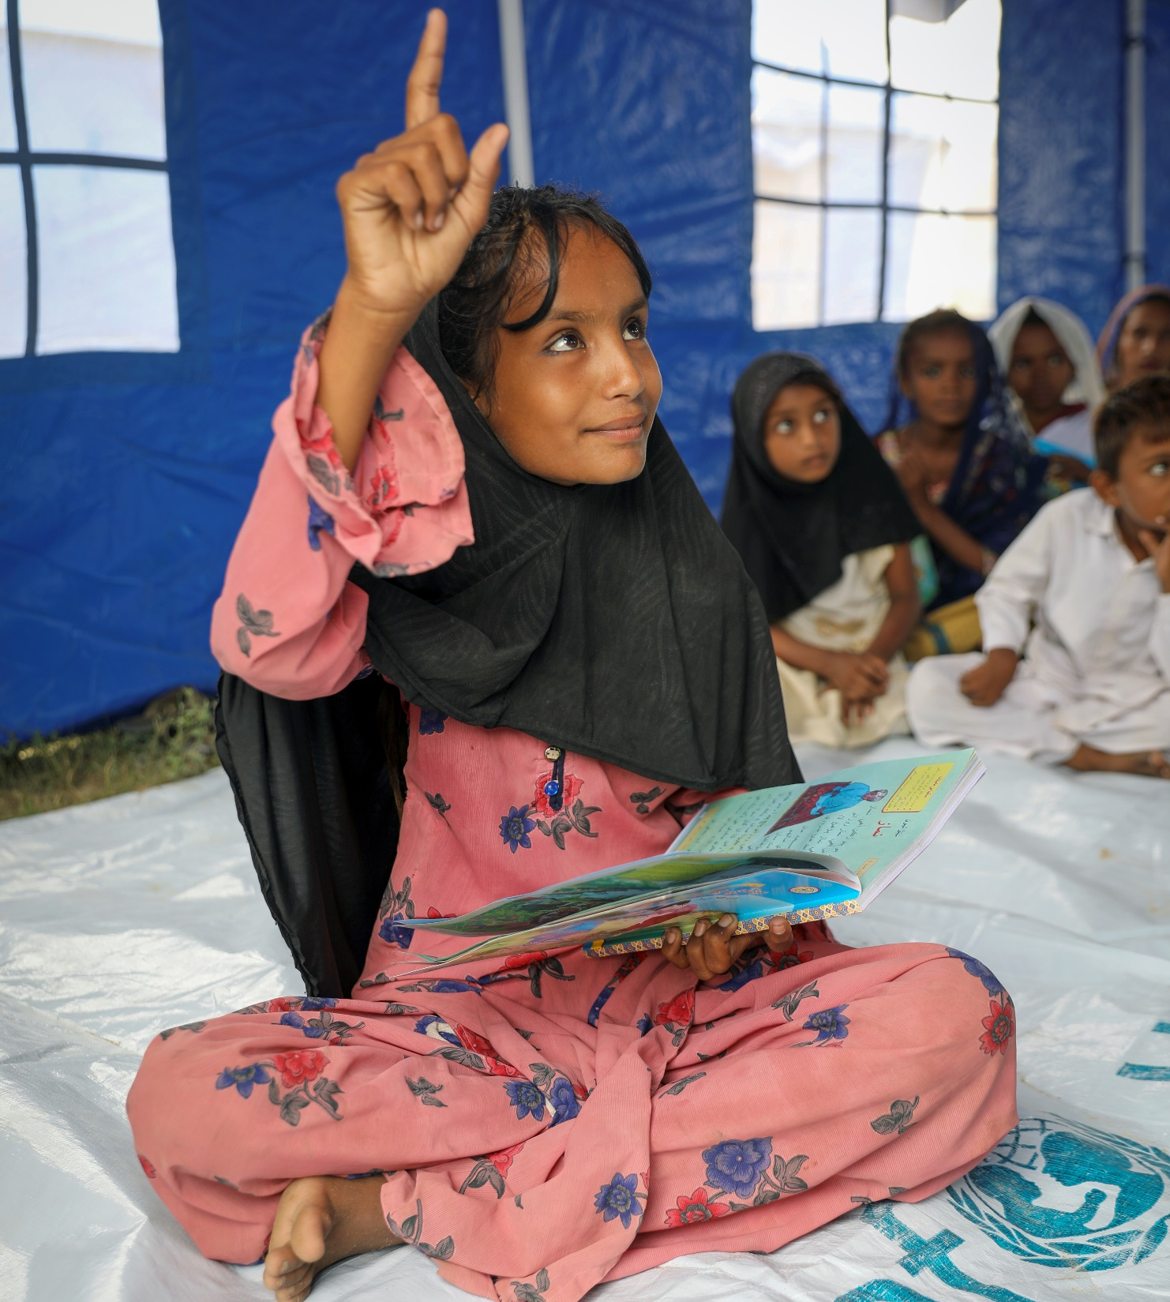
EXPLORING WORLD BOOK DAY
Reading books is an important skill. How can reading help us? List as many answers as you can?
Have a think and write down some answers.
UNICEF/Zaidi

Slide 6
EXPLORING WORLD BOOK DAY
Did you think of these?
We can learn new things about the world
We can enjoy a story that makes you laugh, cry or get excited
It can help us calm down or get to sleep
It inspires us
We can use our imagination
We can share with friends and family
We learn new skills
We can find out how other people view the world and learn about their experiences
It helps your brain to develop
It is a good alternative to spending time on a screen or phone
We get ideas for your own writing and stories
Did you have any others on your list?

Slide 7
PRIMARY ACTIVITIES
You do not need to complete every activity but if you have time, you can try to complete more than one.
Do you have a favourite book? Can you draw a picture of the cover? Talk to a partner and describe what you can see on the cover. Tell your partner what your book is about and why you think they should read it.
Do you have a favourite place to read? Can you think of some words to describe that place? If you have a reading corner in your classroom, have a talk about what makes it special.
Who is your favourite character – can you dress up as your favourite character and say why you like them?
Can you create a story map of your favourite book? Think about the order of the story, draw, or write words to describe the main parts of the story. Can you retell the story to a friend using your map?

Slide 8

PRIMARY ACTIVITIES 2
You do not need to complete every activity but if you have time, you can try to complete more than one.
Listen to this World Book Day song. How many books and characters did you hear mentioned? Can you create your own song/story or poem about reading or your favourite books.
Talk to someone you live with about what their favourite book was when they were your age. Have you read the book?
Find a copy online or in a library and enjoy it together.
Libraries are a great place for reading and to find the books you enjoy the most.
Where is your nearest library?
Find out when it is open and create a poster to advertise its importance. Lots of people use libraries to do research. How does this link to Article 17?
Each year there are various World Book Day live events. See what might be suitable for your class to join. Follow it up by having a discussion in class or creating a piece of art together to represent what you saw and heard.

Slide 9
PRIMARY ACTIVITIES 3
You do not need to complete every activity but if you have time, you can try to complete more than one.
Many books you have in your school will be linked to rights. Choose three books from your classroom or school library and see if you can link them to Articles? How many Articles can your class come up with all together?
Conduct an audit of the books in your school library or class book corner – do the characters and stories reflect a diverse range of people and communities? Can you suggest additional books to create a more diverse range to choose from?
Each year the World Book Day charity has new plans and activities to help you celebrate. Look at their website and see what’s new this year. Which of the books on the website would you most like to read and why?
There are lots of ways in which books and reading support your rights. Look particularly at Articles 17, 29 and 31. Design a chart or diagram with these rights as headings and then ask everyone in your class to fill in their thoughts about how books and reading support each article.

Slide 10
SECONDARY ACTIVITIES
You do not need to complete every activity but if you have time, you can try to complete more than one.
There are lots of ways in which books and reading support your rights. Look particularly at Articles 17, 29 and 31. Design a chart or diagram with these rights as headings and then work in a small group to fill in your thoughts about how books and reading support each article.
World Book Day is about promoting reading for pleasure.
What do you enjoy reading most? It might be a fact or fiction book, magazine, or a poem. Create a piece of artwork to represent why this text is important to you.
Can you link this to Article 31?
Each year the World Book Day charity has new plans and activities to help you celebrate. Take a look at their website and see what’s new this year.
Which of the books on the website would you most like to read and why?
If you have a school librarian or library team, work with them to advertise the importance of the library.
Try to point out how the school library supports several of your rights.

Slide 11
SECONDARY ACTIVITIES 2
You do not need to complete every activity but if you have time, you can try to complete more than one.
Design and carry out a survey in your class or at home to find out how many of your friends and family read books and why.
Is it mostly for pleasure, for information, to learn a new skill or for another reason?
Share the findings of your survey on your school's social media.
Many books you have in your school will be linked to rights. Choose three books from your school library and see if you can link them to Articles.
How many different articles can you find altogether?
Explore how World Book Day links to Articles 17 and 29.
Have you ever been consulted about the textbooks used in school? Which textbooks and resources set out information most clearly and are best at supporting your learning? Work on this with your friends and discuss your conclusions with subject leaders.
Create a ‘Book Swap’ somewhere in your school. Bring in a book from home that you would like to donate and leave it with a short review. Encourage your peers to do the same. Create posters to put up around the school to advertise the scheme.

Slide 12
SECONDARY ACTIVITIES 3
You do not need to complete every activity but if you have time, you can try to complete more than one.
Set up a ‘Reading Ambassadors’ pupil group within your school. Create an action plan with a focus on the promotion of the reading for pleasure. Build upon the activities started on World Book Day throughout the next school year.
Can you link rights into your ideas?
Conduct an audit of the books in your school library to find out if the characters and stories reflect a diverse range of people and communities?
Can you suggest additional books to create a more diverse range to choose from?
Do you know the character Scout from To Kill a Mockingbird, Auggie from Wonder, or even Cinderella? You can look at most characters in books from the point of view of whether or not they get to enjoy all their rights. Pick a character from a book who made an impression on you and create a word cloud or an image to reflect their engagement with rights.
Research local authors who may be able to come in and discuss their work or the importance of reading. If they’re unable to visit, see whether a Zoom or Teams chat might be the next best thing. Prepare some questions to ask the author and see if there is a way of you sharing your knowledge of rights with them.

Slide 13
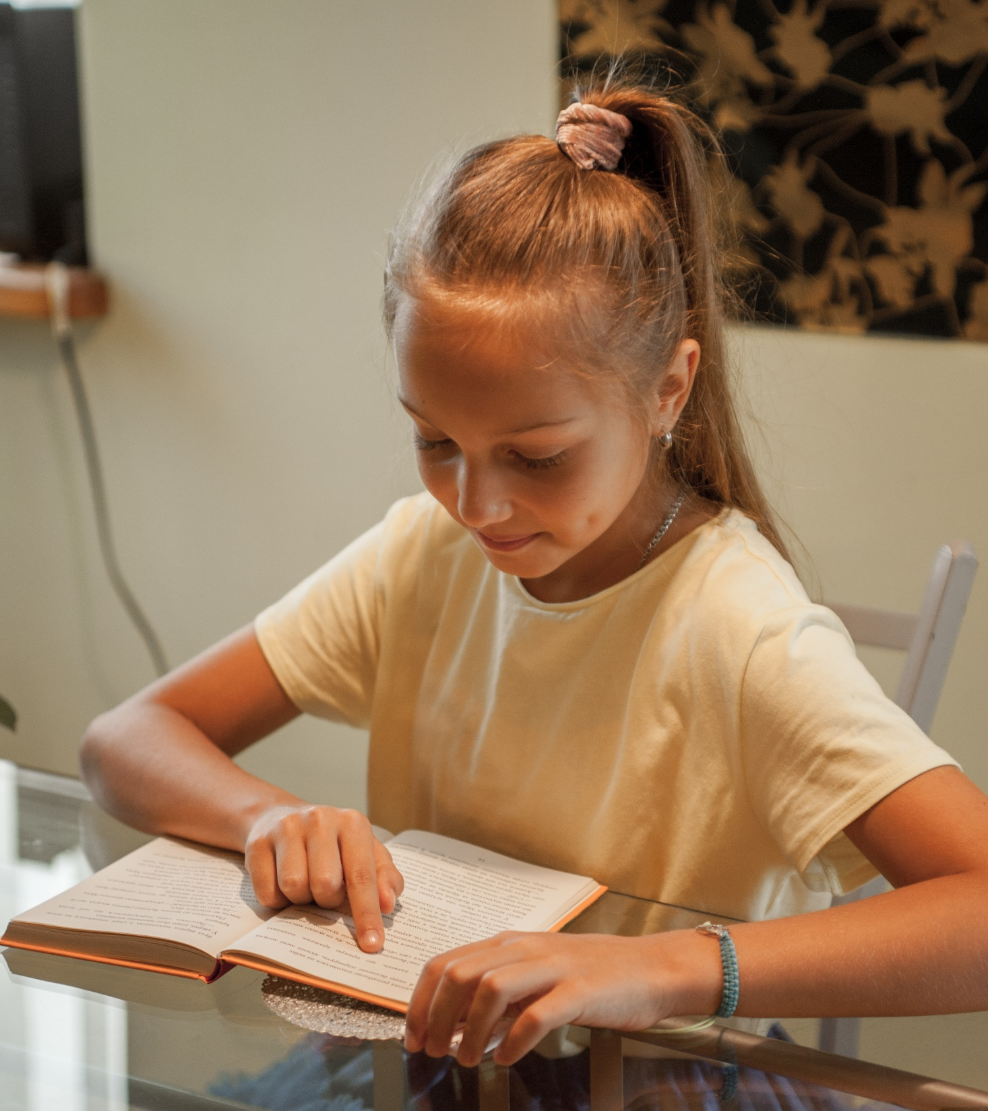
REFLECTION
Find somewhere quiet and allow yourself a few minutes to think:
It has been said that “We don’t need books anymore because we have the internet.”
Do you agree with the statement?
Do books matter to you?
If you could keep only one book from all that you have read, which would it be? What made you choose that one?
Who would you like to tell about this special book?
UNICEF/Moskalenkoi

Slide 14

MORE INFO
RRSA WEBSITE
For more information or to download previous Article of the Week packs please visit the RRSA website by clicking on the link below.
CLICK HERE

