Slide 1
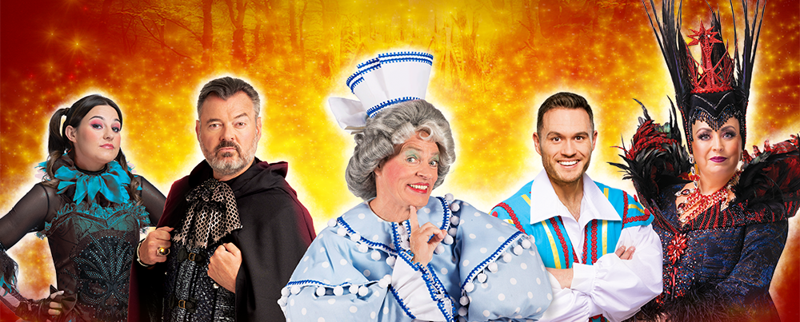
SNOW WHITE AND THE SEVEN DWARFS
VISUAL STORY

Slide 2
The characters

Slide 3
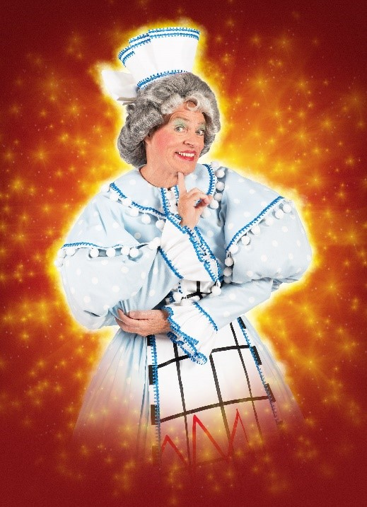
Nurse May is our fabulous Panto Dame. She will be making sure you're all giggling and doing some excellent dance routines. She wears big sparkly and colourful costumes.

Slide 4
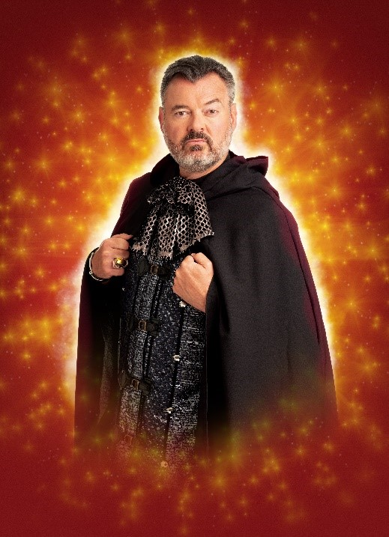
Lord Lucifer is our ‘Man in the Mirror’. He’s out to spoil the fun. A very grumpy man who thinks he’s very handsome and stylish.
When you see him make sure to ‘boo’. He wears dark cloaks and black clothes to try and look sinister… but he actually just looks silly. He also does not like the Trams!

Slide 5
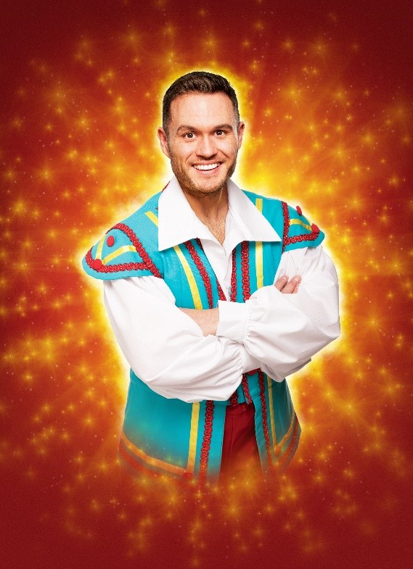
Muddles is one of the friendliest Panto Pals! He’s very energetic and loves nothing more than saying a big “Hiya pals!” to the audience. He’s one of Snow White’s best friends and loves her very much. Nurse May is his mum and she’s very proud of him.

Slide 6
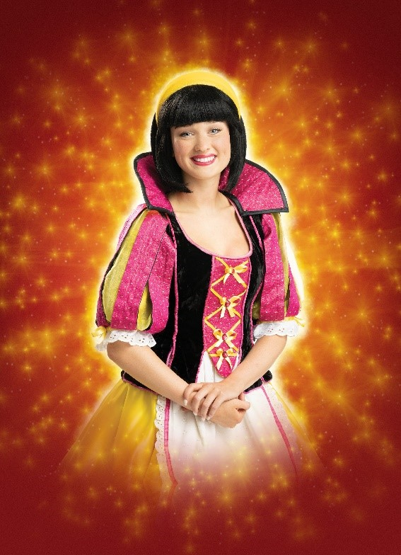
Snow White is the fairest of them all. She has a beautiful singing voice and is friends with whoever she meets.
She has met her Prince and wants to marry him and live happily ever after. She wears beautiful clothes with many bright colours.

Slide 7
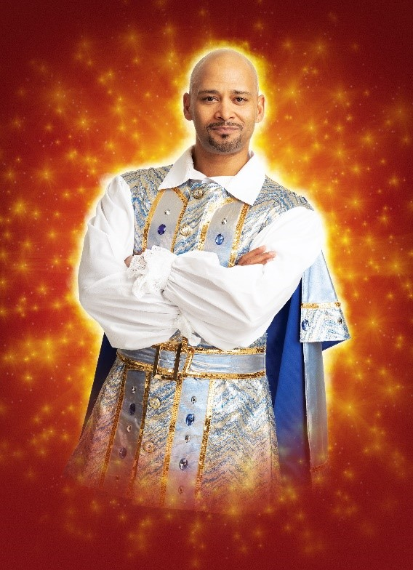
Prince Hamish is our handsome Prince! Like Snow White he cannot wait to be married and he sings almost as beautifully as her. He wears silver clothes of royalty and speak with a lovely deep voice. He is also partial to an apple… which is unusual as Snow White likes them too. They were meant to be!

Slide 8
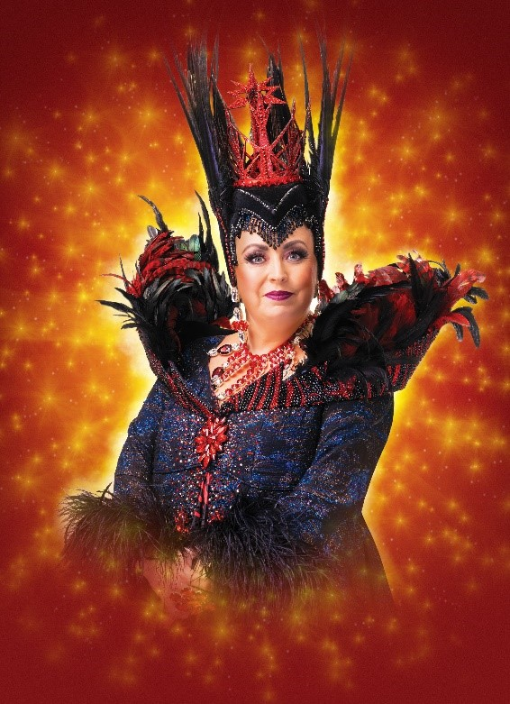
Queen Dragonella is a bad lady and mum to Princess Lavinia. She is jealous of Snow White and her lovely voice and cheerful personality.
She is out to get rid of Snow White and the Seven Dwarfs and take over the kingdom. To do this she becomes friends with Lord Lucifer, her ‘Man in the Mirror’ and they come up with a dastardly plan!

Slide 9
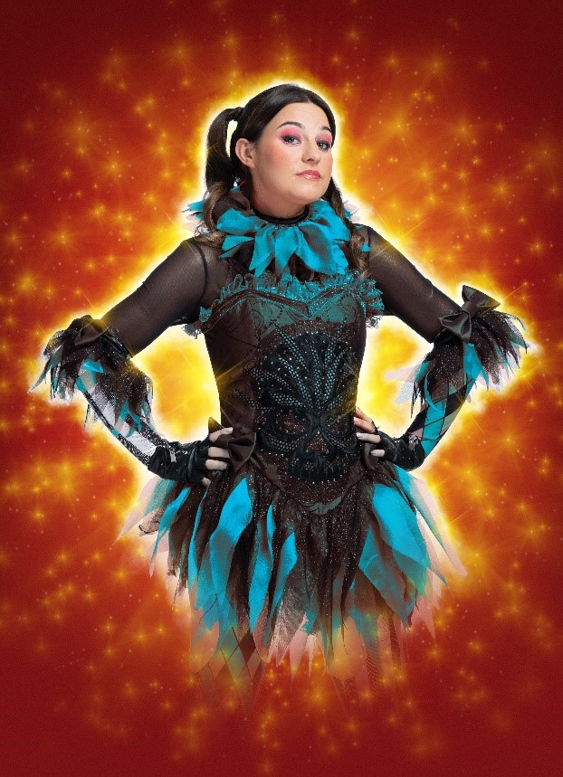
Princess Lavinia is the daughter of Queen Dragonella. Unlike her mum Lavinia has a heart of gold and is very nice. She wants to be good friends with Muddles and make sure that Snow White is safe. She wears cool dark colours and occasionally brighter clothes. She is loyal and brave!

Slide 10
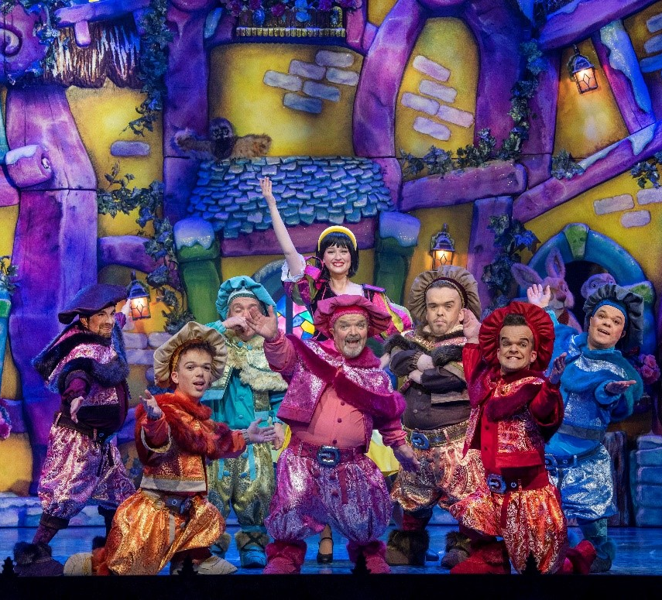
The Magnificent Seven are Doc, Sleepy, Grumpy, Bashful, Dopey, Sneezy, and Happy. They are the Seven Dwarfs. They live in the forest in a cosy and colourful cottage.
Snow White goes to stay with them to stay safe, they looked after her when she was a baby. They are hardworking and loyal to Snow White and will always protect her.

Slide 11
The story

Slide 12
Act One
Welcome to the magical land of Edinburgh (or Auchter-Reekie)! At the start of the show, you will hear a welcome message from Lord Lucifer, our ‘Man in the Mirror’.

Slide 13
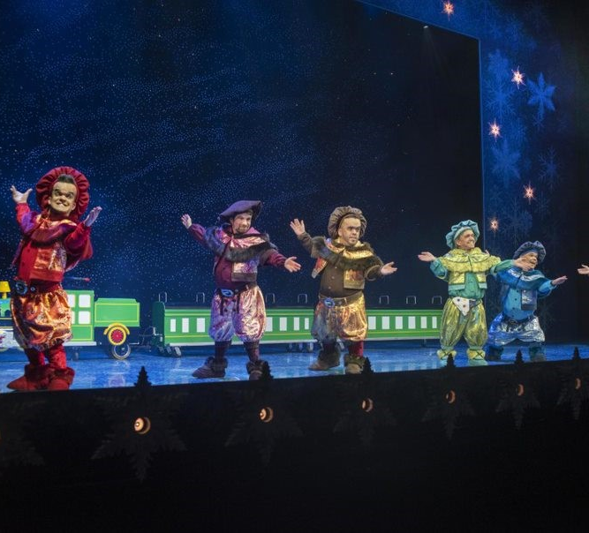
Then we meet The Magnificent Seven, seven friendly dwarfs who live in the woods. They enter the stage on a big green train, singing a cheery song, and we get the feeling that this might be a friendly group.

Slide 14
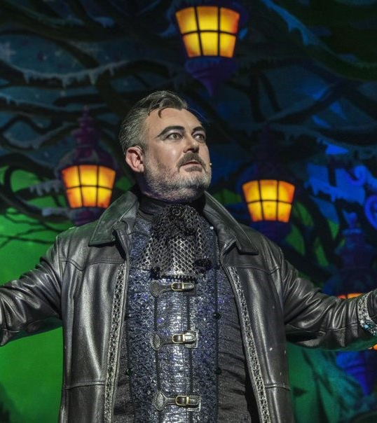
Lord Lucifer enters. We can tell by his dark clothing and bold behaviour that he is a character not to be trusted, so you might hear people ‘booing’ him. Feel free to join in. He might tell you to ‘listen’ or ‘be quiet’, but don’t feel that you need to do as he says!
Lord Lucifer tells us about Snow White. Snow White’s father was the king, but her evil stepmother Queen Dragonella did away with him and now rules the land herself. She is very jealous of Snow White because she is kind and beautiful.

Slide 15
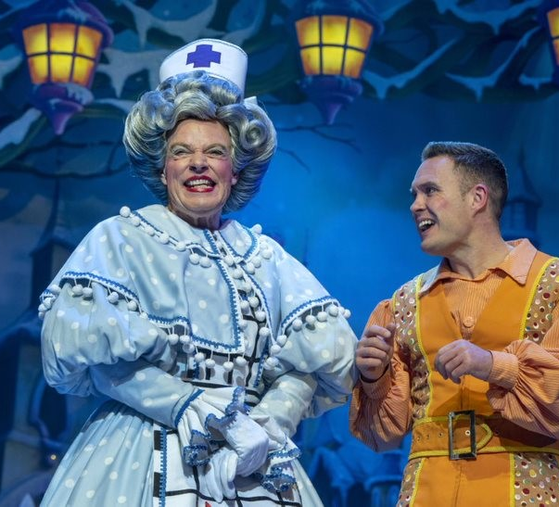
At a party, Snow White meets Prince Hamish and to their surprise, they fall in love immediately!
Soon Snow White and Prince Hamish meet her friends Nurse May and her son Muddles who loves it when you shout ‘Hiya Muddles!’.

Slide 16
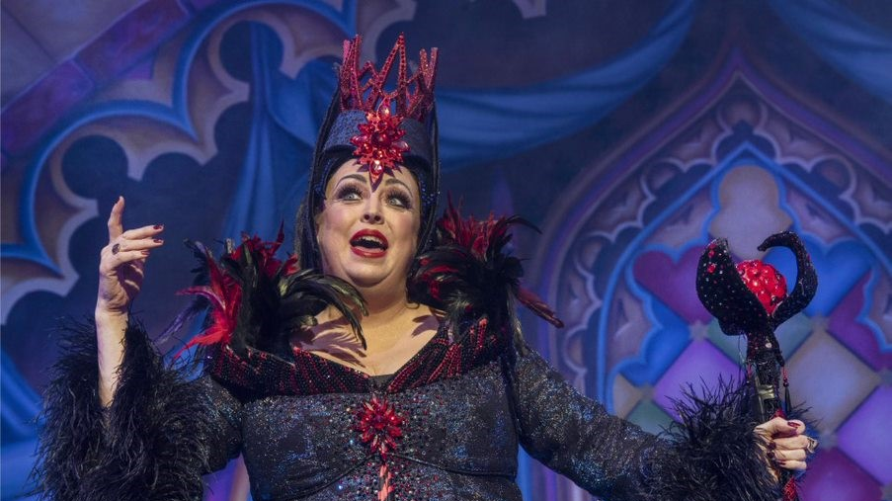
When the friendly gang go to get ready for The Winter Festival, Queen Dragonella comes on stage. She demands that Lord Lucifer tells her that she is the fairest in all the land... but he can’t because it’s not true! Snow White is really the fairest. Even Dragonella’s daughter, Princess Lavinia, agrees.

Slide 17
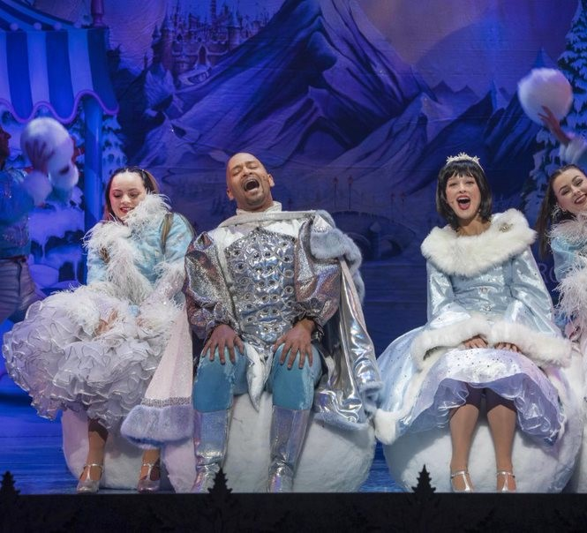
Now it’s time to go to The Winter Festival! Everyone dances and has a lovely time singing winter songs.

Slide 18
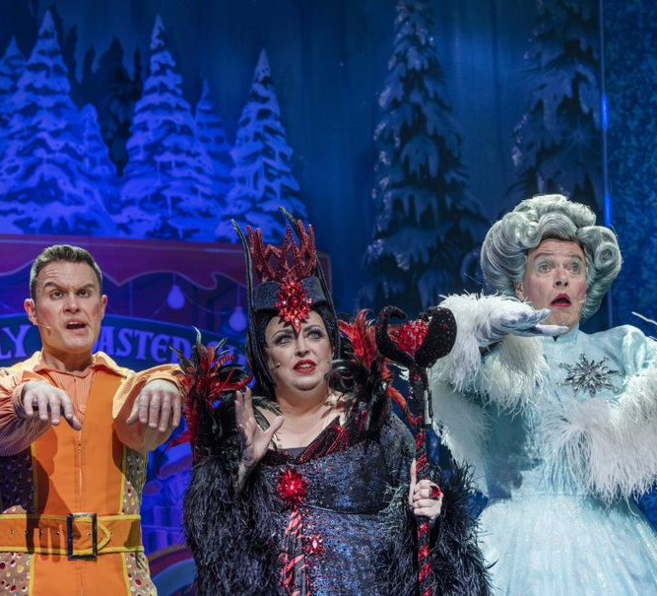
Once Snow White and Prince Hamish leave, Queen Dragonella enters. She has decided that she is going to be the one to marry the prince, not Snow White! She tries to persuade Muddles and Nurse May to lure Snow White into the forest so they can do away with her. They refuse, so Dragonella places an evil curse on them, hypnotising them to do as she commands.

Slide 19
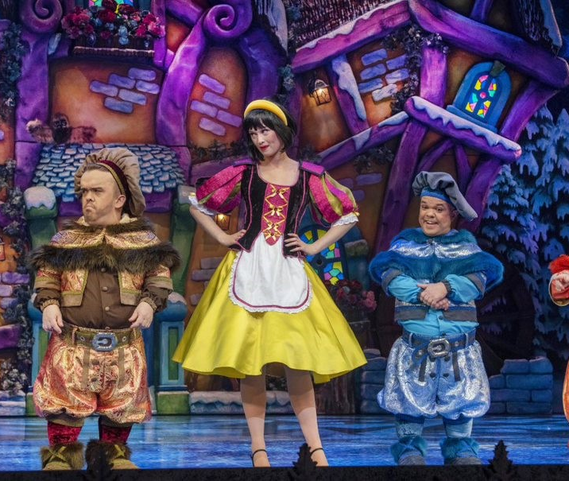
Still in a trance, Muddles and Nurse May bring Snow White to the forest. Thankfully, Princess Lavinia enters and uses her own good magic to undo Dragonella’s curse.
To keep her safe, Snow White’s friends hide her in a little cottage in the woods – where the Magnificent Seven live! They are very pleased to see her. While Snow White tidies up, her friends go back to the palace to tell Dragonella they’ve done as she asked – this means Snow White will be safe from Dragonella’s evil plan.

Slide 20
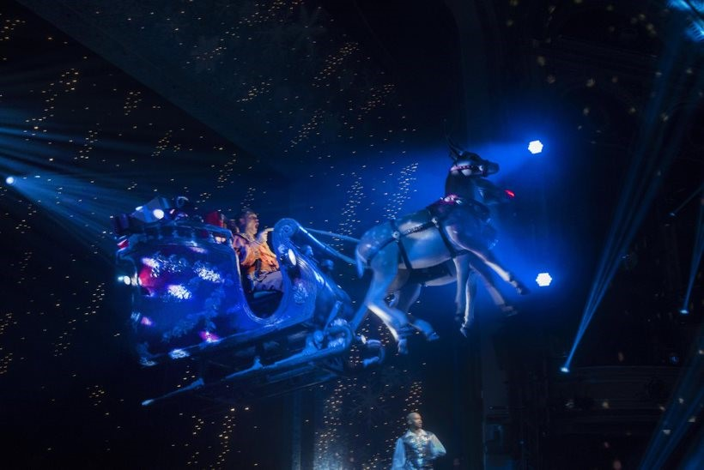
Prince Hamish meets Muddles and asks him to take him to Snow White. Muddles agrees, and flies to the forest on his magical sleigh. The lights will go dark here, but this is nothing to worry about – it’s just so that we can see how magic the sleigh looks against the starry sky.

Slide 21
Now we’re at the end of the first act. We call this break The Interval. This is a good time to use the toilet if you need, have a snack, or even enjoy an ice cream!

Slide 22
Act Two

Slide 23
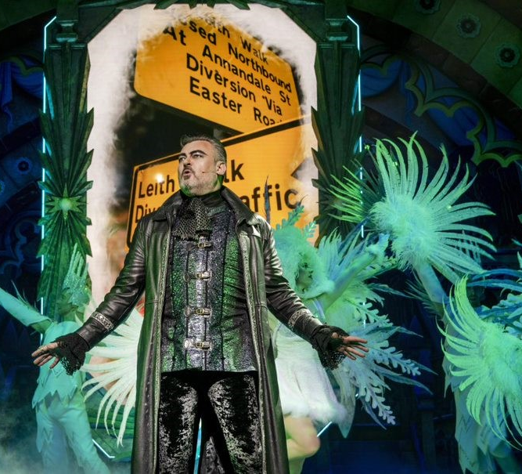
Lord Lucifer enters and sings a song about how much he hates Edinburgh’s trams.

Slide 24
After he leaves, Nurse May and Muddles make silly noises as they cross the stage. Prince Hamish finds them and asks them to remember where they hid Snow White.
Muddles gives a funny run-down of everything that has happened in the show so far. He speaks very very fast here, so don’t worry if you don’t manage to hear everything!

Slide 25
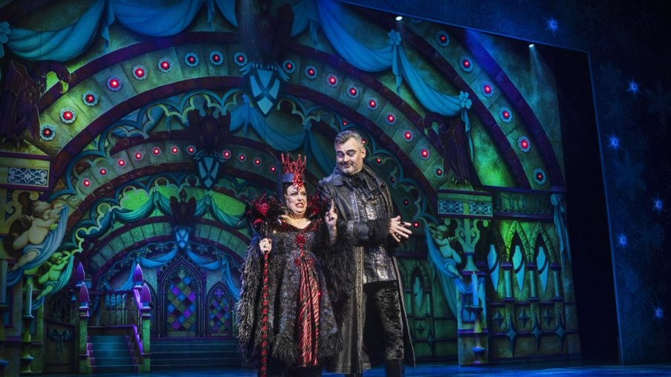
The nasty Dragonella enters and once again asks The Man in the Mirror who is the fairest in the land. Again, he tells her Snow White, revealing that Snow White is alive after all.

Slide 26
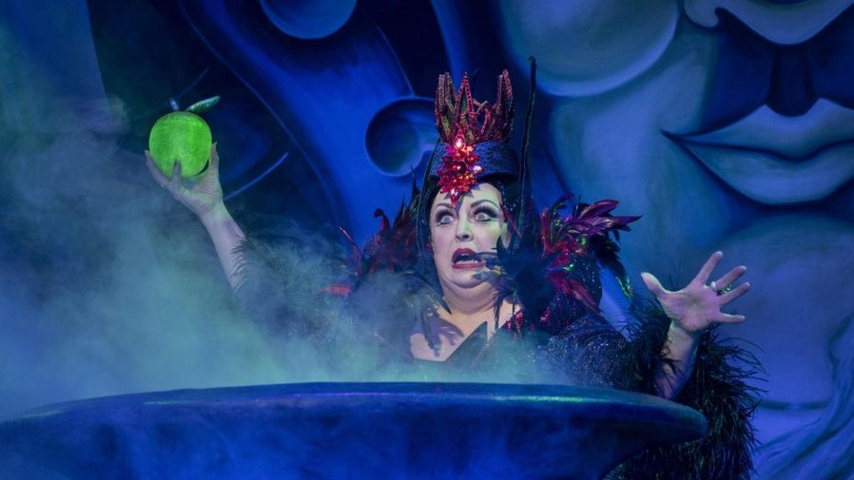
Dragonella is very angry and decides to remove Snow White herself. She decides that she will trick Snow White into eating a poisoned apple and disguises herself as an old hag to give it to her. It’s alright though – we know that Snow White’s friends will look after her.

Slide 27
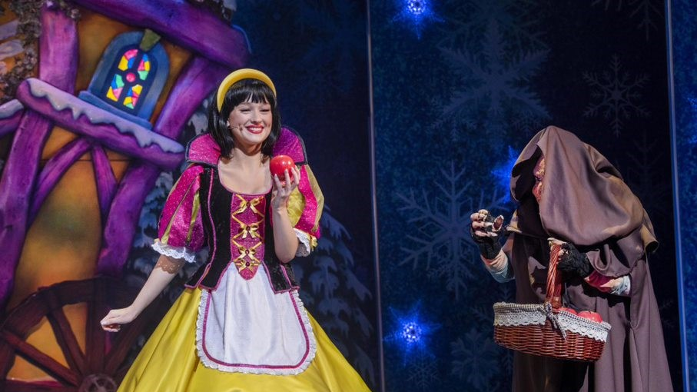
Back at the cottage Snow White is thinking about how much she loves the Magnificent Seven when Dragonella arrives in disguise to give her the poisoned apple! Snow White isn’t sure if she should eat the apple. You can call out to warn her, if you want to.

Slide 28
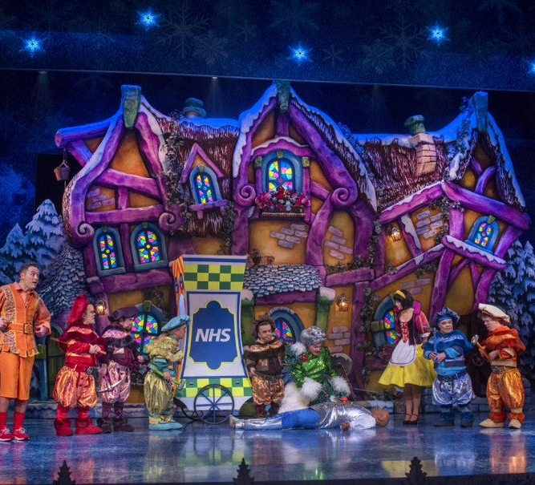
Prince Hamish arrives in time to stop her eating it but takes a bite himself and falls down on the ground! Don’t worry, he’ll be alright – his magical friends are looking out for him.
Angrily Dragonella throws off her disguise and tells everyone she will set fire to the forest in revenge! But Snow White’s friends arrive at the cottage to help make sure everyone gets back to the palace safely.

Slide 29
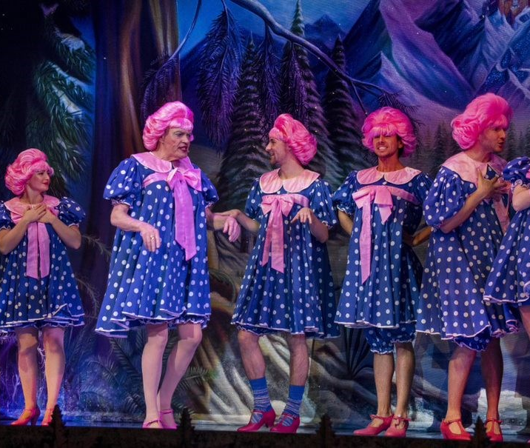
Alone, Snow White sings a lovely song about wishing her dream will come true.
Then Nurse May sings a funny song about how fun it is being a dame – look out for a familiar face or two!

Slide 30
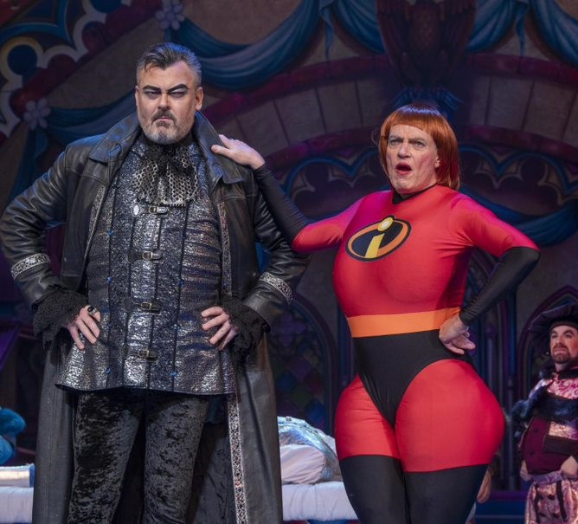
Back at the palace, the team confront Dragonella with the help of two superheroes – Mr and Mrs Incredible!

Slide 31
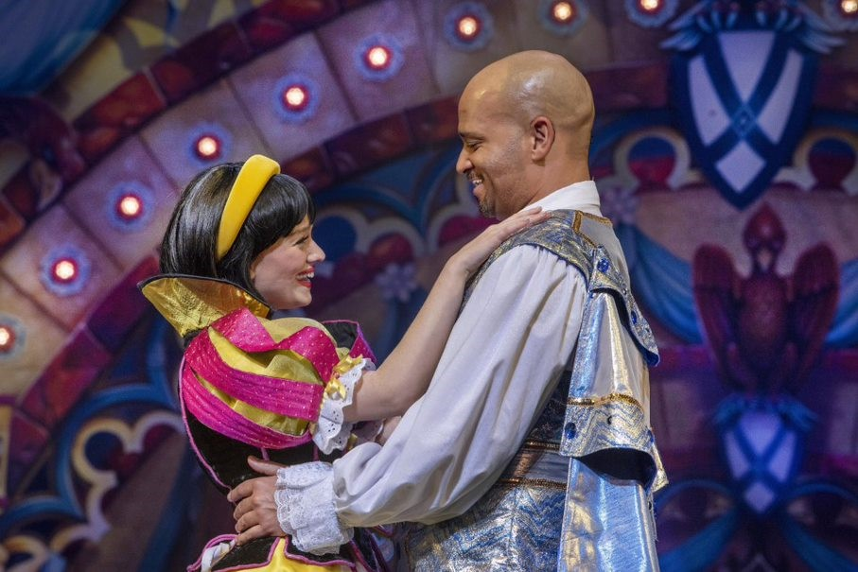
Dragonella tries to cast an evil spell, but Snow White knows how to break it. Dragonella is trapped in the magical mirror, and everyone is happy. We are all invited to Snow White and Prince Hamish’s wedding!

Slide 32
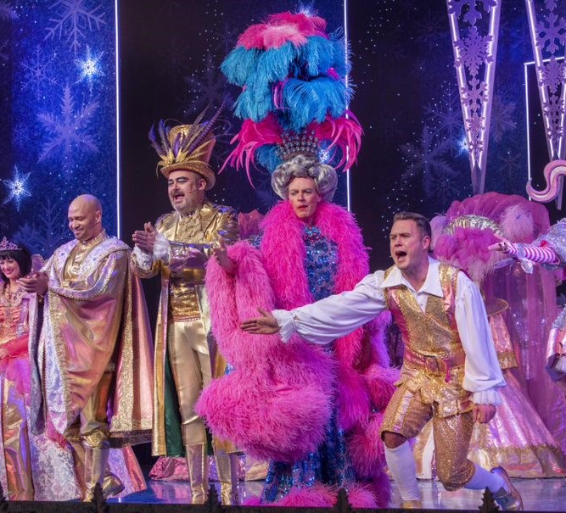
Everybody comes back on stage to take a bow. You can clap and dance along to the music if you want to.
Then, the panto stars will perform a silly song about Christmas presents. They have 12 different presents to remember, so they can get a bit muddled at times, but that’s all part of the fun!

Slide 33
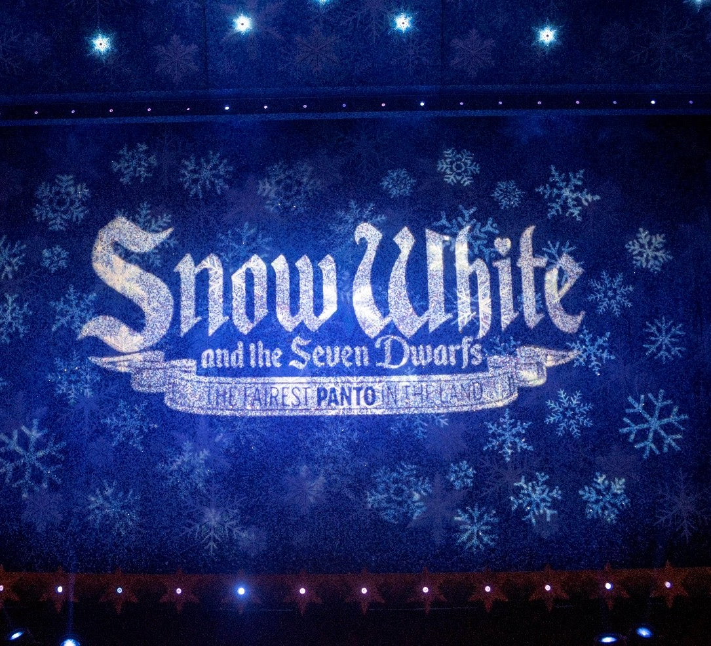
At the end of the show, please stay in your seats. Our staff will let each school know when it’s your turn to leave, and they will help you find your way back to your bus. We will have lots of staff to help keep everyone safe – please feel free to ask them if you have any questions.
We hope you had a wonderful time at the panto!

