Slide 1
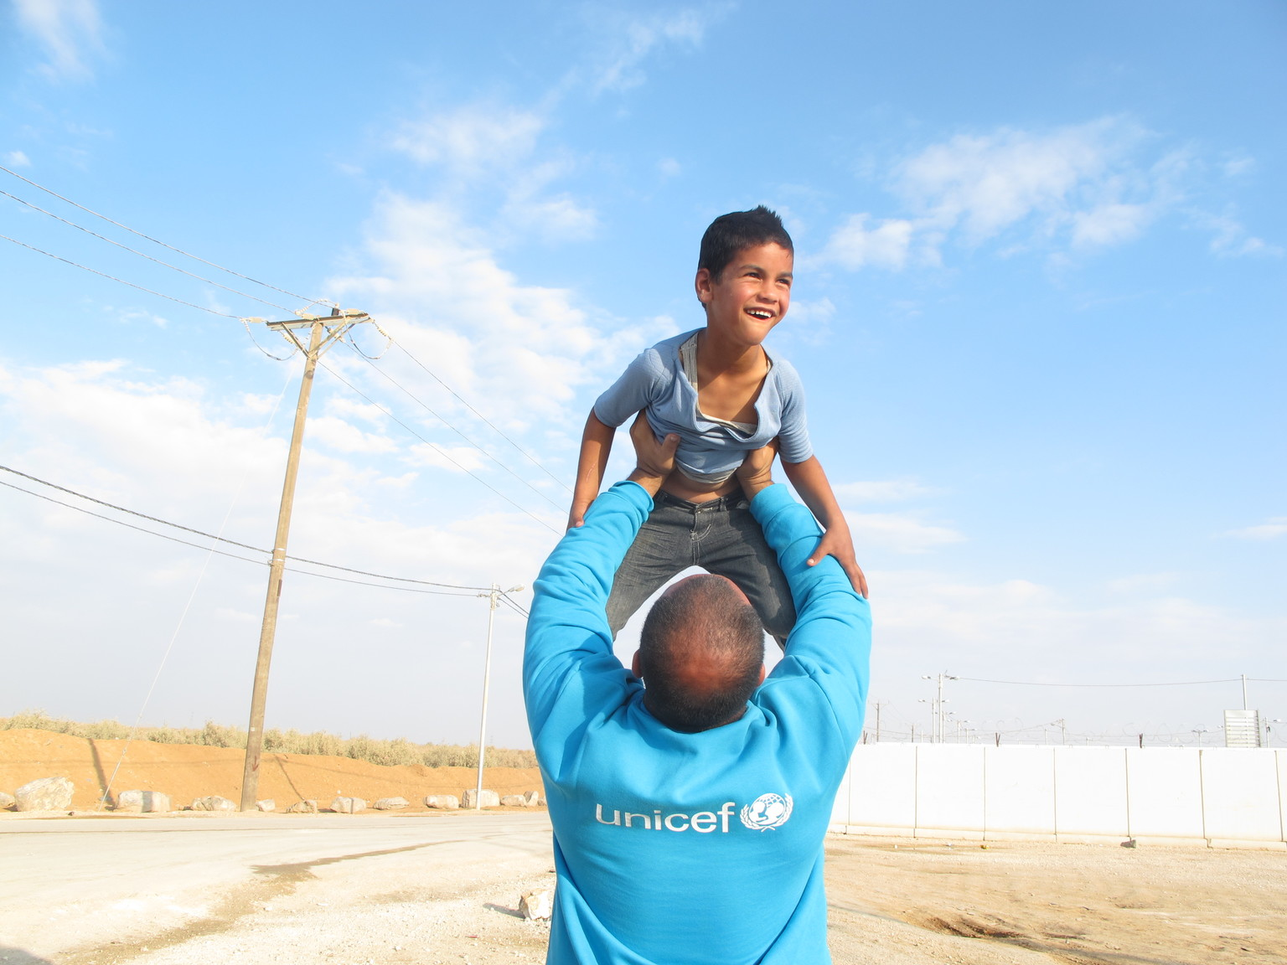
© UNICEF/UN069007

Slide 2
Slide 3 – Guess the article
Slide 4 – Introducing Article 45
Slide 5 – Exploring Article 45
Slide 6 – Some possible answers
Slides 7&8 – Primary Activities
Slides 9&10 – Secondary Activities
Slide 11 – Reflection

Slide 3

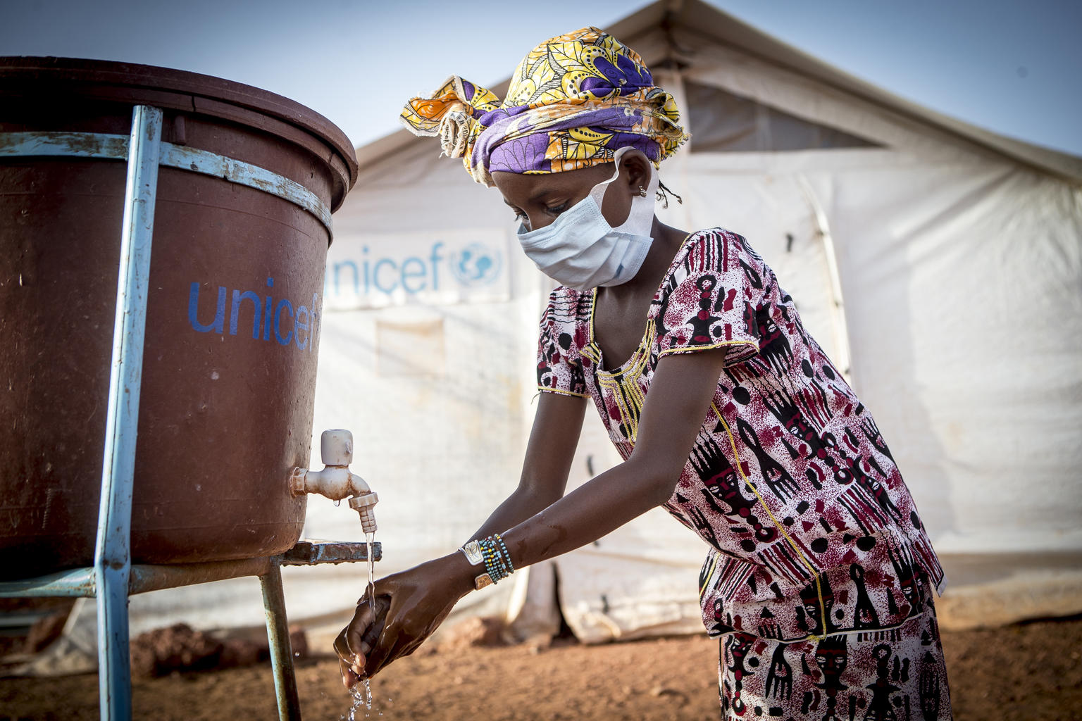

Guess the Article
These pictures provide a clue to this week’s article.
How do these pictures help you? Can you guess how they are linked together?
Write down your thoughts or discuss with someone in your class.
@UNICEF/Hugh Rutherford
@UNICEF/ Seyba Keïta
@UNICEF/Dawe

Slide 4
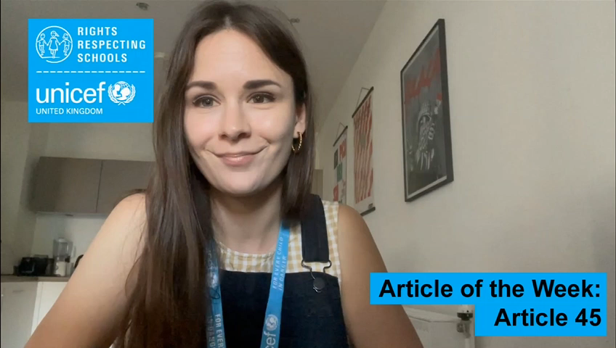

INTRODUCING ARTICLE 45
Romana Juhasova from the RRSA team introduces Article 45
Article 45
UNICEF can provide expert advice and assistance on children’s rights.
Click here to watch on YouTube

Slide 5
EXPLORING ARTICLE 45
In what different ways does UNICEF help children around the world?

Slide 6
Did you think of these?
UNICEF…
helps governments make sure that all children have an education
supports communities to have access to clean water and nutritious food
helps to support good health care systems in lower income countries
distributes vaccines to protect children from a wide range of diseases and infections
works to make child protection stronger where countries or organisations need help with this
helps governments all around the world to look at how children’s rights are being met and helps them improve the situation for children
provides help for children when there is an emergency situation such as an earthquake, hurricane or tsunami
provides help for children if there is a war to make sure children are looked after
supports refugee families in a variety of ways
works within the United Nations and with governments and civil society to make sure children’s lives and views are visible and taken into account
in the UK promotes children’s rights through the Baby Friendly Initiative, Rights Respecting Schools Award and Child Friendly Cities and Communities programme
in the UK and other high income countries it raises funds to support UNICEF’s work around the world
speaks to politician and decision makers to protect and promote children’s rights
What else did you think of?

Slide 7


Wants and Needs (use the Wants and Needs cards if you have them) – Discuss what the difference is between a need and a want. Explore the fact that some children don’t get all that they need and talk about how UNICEF helps to support children in nearly 200 countries.
Watch this video together as a class. See how many rights you can count. Pause to explore how you think UNICEF supports some of the rights referred to.
Is there anything about UNICEF UK or wider UNICEF work that you’d like to ask the Executive Director of UNICEF UK, Jon Sparkes? Send your questions in a written form along with your first name and your school’s name to romanaj@unicef.org.uk by 9 September. Jon will answer them at our virtual RRSA conference.
Watch this video to find out about UNICEF’s work on education. As a class, discuss what the stories have in common.

Slide 8
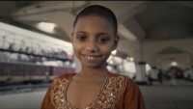

Use your knowledge of children’s rights and how not all children around the world can access all their rights to create an advertisement appealing for donations for UNICEF’s work. Make it positive, about finding solutions and making a difference. It could be a poster, a short audio advert for radio or a simple video. Be creative – this video might inspire you.
Research the history of UNICEF and prepare a display or a presentation for an assembly.
Find some information here to get you started.
Did you watch Soccer Aid for UNICEF last month? If not, catch up on ITV Hub or have a look at this report. Find five fascinating facts about Soccer Aid 2022 to share with your class.
Did your school take part in the Soccer Aid Schools Challenge?
Have a look on the UNICEF UK website to find out more about UNICEF UK’s work. What do you think is most interesting? Identify five facts to share with someone in your class.

Slide 9


Watch this short video about UNICEF, then watch again and note down some of the language used. Discuss this vocabulary, then work with a partner to write a poem, song or rap about the meaning and importance of what UNICEF does. Please share it with us at rrsa@unicef.org.uk
Research the history of UNICEF and prepare a presentation for a year group or school assembly. Find some information here to get you started.
Article 45 says that UNICEF can help governments to ensure that all the children in their country can access their rights. Think about some of the challenges faced in some lower income countries. Why do you think help is needed and why might countries turn to UNICEF? Explore this in a class discussion.
Is there anything about UNICEF UK or wider UNICEF work that you’d like to ask the Executive Director of UNICEF UK, Jon Sparkes? Send your questions in a written form along with your first name and your school’s name to romanaj@unicef.org.uk by 9 September. Jon will answer them at our virtual RRSA conference.

Slide 10
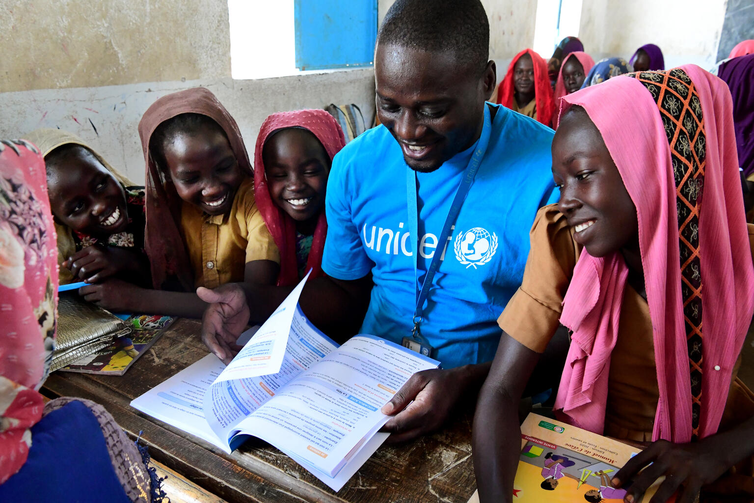
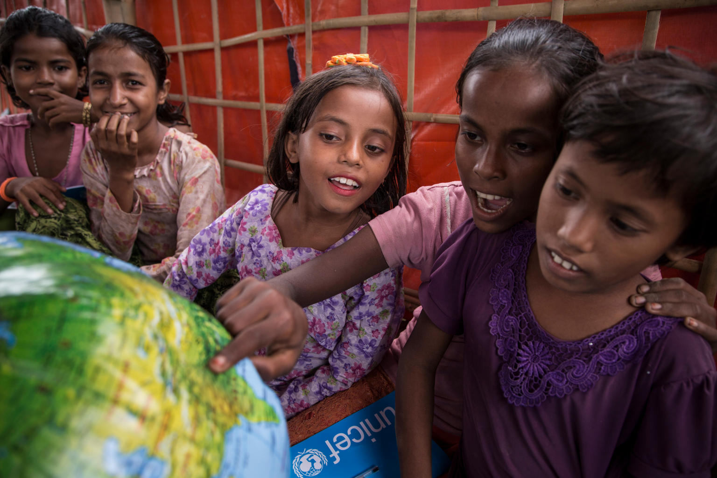
Look at UNICEF’s work on education, nutrition, protection from violence, water and sanitation and vaccination. Can you produce a leaflet explaining one of these areas of UNICEF’s work, suitable for younger children?
Find out what UNICEF does around the world. Follow the different links on this website to gather information to design a quiz for other students in your class.
UNICEF works in more than 190 countries and territories. Choose a country you are interested in and find out what work UNICEF does there. Look at the country site to find out more. Compare the work in different countries.
Have a look on the UNICEF UK website to find out more about UNICEF UK’s work. What do you think is most interesting? Identify five facts to share with someone in your class.

Slide 11
REFLECTION
Try to find somewhere peaceful and spend a few minutes being quiet and still … then think about these questions…
Think about all the amazing things that UNICEF does to make life better for millions of children around the world every day.
What have you learned about UNICEF’s work?
What will you do to tell other people about UNICEF’s work?
How might you support UNICEF in the future?
UNICEF UK/Dawe

Slide 12

MORE INFO…
RRSA WEBSITE
For more information or to download previous Article of the Week packs please visit the RRSA website by clicking the link below
CLICK HERE

Slide 13
Thank you
UNICEF UK/Dawe
Notes:
UNICEF UK/Dawe

