Slide 1
ARTICLE OF THE WEEK
Notes:
Pupil drawing at his desk at a nursery in Cairo, Egypt

Slide 2
INSTRUCTIONS
Slide 3: Guess the article
Slide 4: Introducing Article 28
Slide 5: Exploring Article 28
Slide 6: Some possible answers
Slide 7: Transforming Education Survey
Slide 8, 9 & 10: Primary activities
Slide 11, 12 & 13: Secondary activities
Slide 14: Reflection

Slide 3
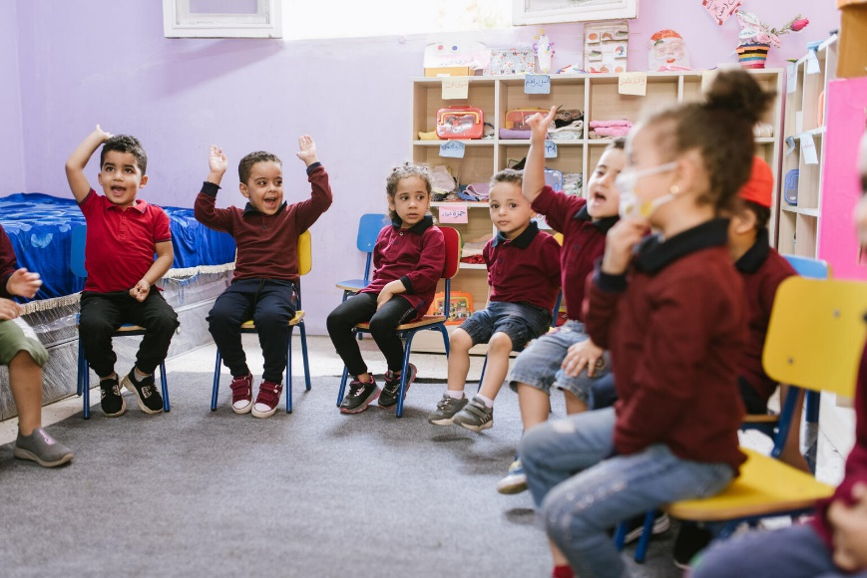
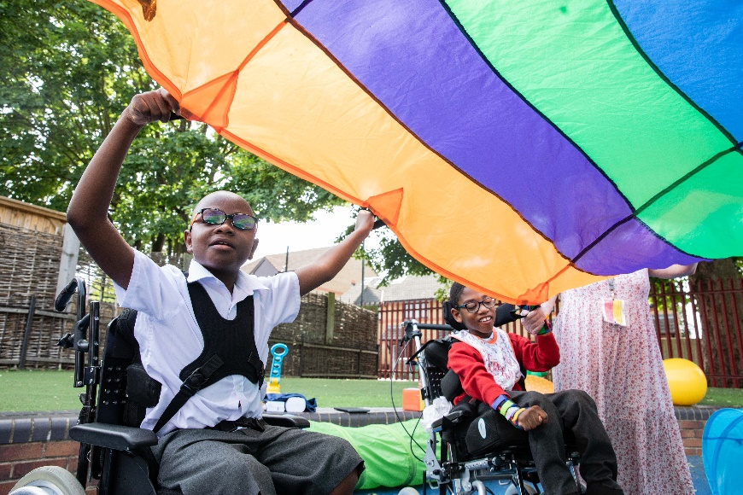
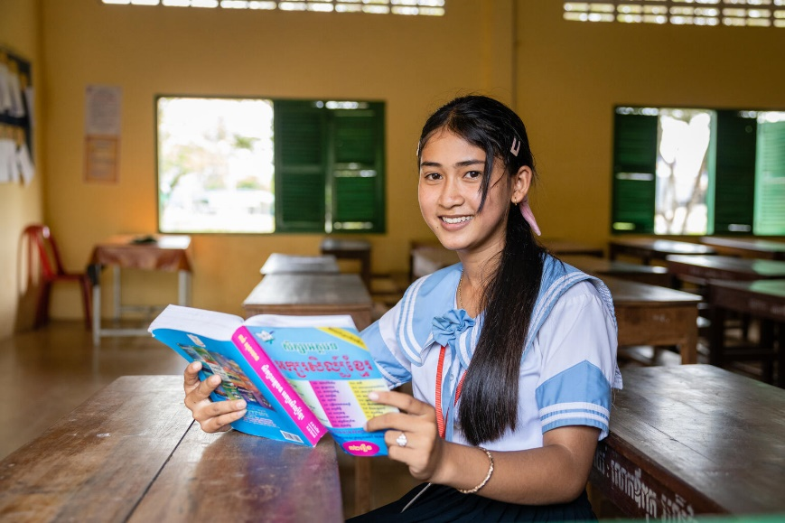
GUESS THE ARTICLE
@UNICEF/Soliman
@UNICEF/Dawe
@UNICEF/But
These pictures provide a clue to this week’s articles.
How do these pictures help you? Can you guess how they are linked together?
Write down your thoughts or discuss with someone in your class.

Slide 4
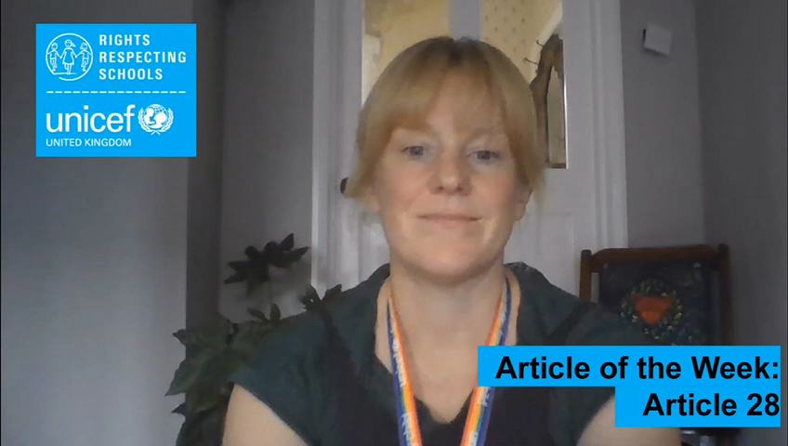
ARTICLE 28
Article 28 (right to education)
Kathy Allan, RRSA Professional Adviser, introduces Article 28
Article 28 says that all children across the world have the right to access primary education for free, and secondary education must be available to every child.
But, just as important is the quality of the education that is received – just being in a school is not enough. Article 28 also speaks of the importance of children being treated with dignity in their school setting. Also, it places additional responsibility for global education on richer countries, as it makes clear that they must help poorer countries to ensure that all children can access their right to education.
This Article of the Week pack will focus on Article 28. Some activities are also linked to Article 29 which is closely related as it describes what the goals of education should be, including helping children to have respect for human rights, their parents, different cultures and for the environment.
Click here to watch on YouTube

Slide 5
EXPLORING ARTICLE 28
Give yourself one minute to think of as many reasons as you can why education is so important for children and young people.
Have a think and write down some answers.

Slide 6
EXPLORING ARTICLE 28
Did you think of these?
It gives you skills to improve things and help people.
It helps you form opinions and views about things.
You learn things, gain knowledge and pass exams.
You are taught how to stay safe and healthy.
You learn how to respect other people’s ideas and get on with other people.
You can learn about rights and why they matter.
It helps you to get a job you enjoy and earn money in the future.
You explore different opinions and can make informed choices.
Education helps you to have more opportunities in life.
You learn about things that are important for the world like the environment.
You find out about different cultures and people’s beliefs.
It helps you grow up to be responsible adults.
Learning is fun, and you can make friends and meet new people.
Learning is something you will do for your whole life.
What else did you think of?

Slide 7

EXTRA
World’s Largest Lesson Transforming Education Survey
As we all know, the pandemic has had a huge impact on children’s education. But now we have an opportunity to discuss how we could reimagine education systems so that every child can flourish. Support your pupils (aged 10+) to have their say and share the World’s Largest Lesson Transforming Education Survey with them. Please use this link.
It only takes 10 minutes and can be completed individually or in discussion with classmates. Everything they say will be anonymous and the answers will help organisations, including the United Nations, improve education for everyone.
Teacher guide for facilitating the survey can be found here.

Slide 8

PRIMARY ACTIVITIES
You do not need to complete every activity but if you have time, you can try to complete more than one.
Article 28 says that all children have the right to an education. Read the book All are Welcome about children going about their day at school where all children are welcome or listen to it on YouTube. How are all children welcomed in your class?
Learning is really fun! What do you like about learning? Draw a picture of your best day at school and create a display celebrating the fact that you are enjoying your right to education.
What do classrooms look like across the world? Have a look at these photos gathered by UNICEF for World Teachers’ Day or find some images through your own research. Can you find five similarities and five differences from your classroom?
Imagine you have been asked to create your ideal lesson timetable for a day or a week at school. Plan it out and decide what you would include and what you would leave out. Make sure it will provide children with a really good quality education!
(Have a read of Article 29 to give you some ideas.)

Slide 9

PRIMARY ACTIVITIES 2
You do not need to complete every activity but if you have time, you can try to complete more than one.
Article 28 highlights that ‘Discipline in schools must respect children’s dignity and their rights.’ Discuss in small groups what you think this means. What does ‘dignity’ look and feel like in your school? Create an acrostic poem to share with your class and the wider school community.
Send My Friend to School supports young people to campaign for every child’s right to a quality education. Read this case study and encourage your school to take part in the campaign.
What do you think makes a good teacher? This video might give you some ideas! Draw an outline of your ideal teacher and surround it with words that describe what that teacher is like.
Teachers and learners go together! So, now think about what makes a good learner. Imagine you are talking to a younger brother, sister or friend who is about to start school. Describe to them how to be a really good learner. You can invent a cartoon character to represent this good learner.

Slide 10
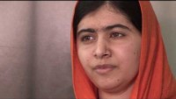
PRIMARY ACTIVITIES 3
You do not need to complete every activity but if you have time, you can try to complete more than one.
Schools and teachers do so much more than teach you facts. Think of everything that happens at your school – how the adults look after you and treat you with dignity and respect, how you look after each other. Now write a ‘recipe’ for a Rights Respecting School. What are the ingredients? How do you mix them together to create the best rights respecting learning environment?
The Covid-19 pandemic has impacted on the number of children across the world accessing their right to education both in the UK and countries across the world. This clearly goes against Article 28 and Global Goal 4. Look at the facts in these two videos from UNICEF and from The World’s Largest Lesson. How could you share this knowledge in your school, in your community and with decision makers?
Malala Yousafzai was awarded the Nobel Peace Prize for her work on the right to education, particularly for girls. Watch this video. How can you be a changemaker and stand up for every child’s right to education? As a class, make a list of the different ways that you could take action to support this right for children across the world and then decide which action would have the most impact.
As a class have a read of the full version of Article 29 (page 9). Imagine you were going to invent an education system for a brand-new country: what would be the top ten things you would include? Think carefully about what you think children need. Work in groups then present and compare your ideas.

Slide 11
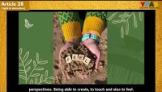
SECONDARY ACTIVITIES
You do not need to complete every activity but if you have time, you can try to complete more than one.
If you became the new Education Minister in the Government, what would be the first thing you would do? Think carefully about what you think children and teachers need. You could have a go at writing your first speech describing the improvements you would make. Have a read of the full version of Article 29 which might give you some ideas (page 9).
Imagine you have been asked to create your ideal lesson timetable for a day or a week at home or in school. Plan it out and decide what you would include and what you would leave out. Remember what Article 29 says and make sure it will provide children with a really good quality education!
Discuss the things you value about your education and why is the right to an education important. Watch this video which explores this a bit further – do you agree with all the ideas? Would you like to add anything else? How could it be even better? Create an image or word art that sums up what education means to you.
What do you think makes a good teacher? This video might give you some ideas! Draw an outline of your ideal teacher and surround it with words that describe what that teacher is like.

Slide 12
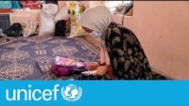
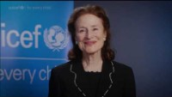
SECONDARY ACTIVITIES 2
You do not need to complete every activity but if you have time, you can try to complete more than one.
Sometimes girls are not given the same access to education as boys, for example in Afghanistan, girls’ access to secondary education is being limited. Watch this video and consider the different ways that you could take action to support girls across the world to access their right to education.
Send My Friend to School supports young people to campaign for every child’s right to a quality education. Read this case study and encourage your school to take part in the campaign.
The Covid-19 pandemic has impacted on the number of children across the world accessing their right to education both in the UK and countries across the world. This clearly goes against Article 28 and Global Goal 4. Look at the facts in these two videos from UNICEF and from The World’s Largest Lesson. How could you share this knowledge in your school, in your community and with decision makers?
Although more children than ever go to school across the world, the quality of the education they receive is not always good enough for real learning to take place. Watch this video in which Henrietta Fore, UNICEF’s previous executive director, talks about the importance of children learning at school. What do you think is needed for quality learning to take place?

Slide 13
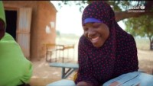
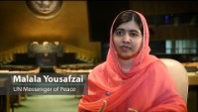
SECONDARY ACTIVITIES 3
You do not need to complete every activity but if you have time, you can try to complete more than one.
Article 28 also says that ‘Discipline in school must respect children’s dignity.’ What do you think this means in practice? Imagine you are the Headteacher of a new school. As well as ‘dignity’, what other three values would you place at the heart of your school? How can you ensure that everyone respects these values? Design a school motto or logo to illustrate this.
Watch this video which highlights UNICEF projects to reduce the impact of early marriage on the right to education. Find out more here and find a way of sharing this information in your school.
Talk to relatives or friends who are older than you and ask them what school was like for them. What are their best and worst memories? How has school changed? How do you think knowing about rights improves life and learning in school?
Nelson Mandela said: ‘Education is the most powerful weapon which you can use to change the world’. In the same spirit, Malala Yousafzai campaigns to raise awareness of the importance of education for girls. Listen to Malala and watch this video and highlight 3 key points about why it is important for girls to go to school. How might you use these 3 key messages to start your own campaign for girls’ education?

Slide 14
REFLECTION
Take some time to think about and reflect on the right to education…
What’s the best thing about your education?
Children’s rights are universal and indivisible and the right to a good quality education is an example of how rights are interdependent. For a child to enjoy a good quality education lots of other rights need to be accessed too – health, for example. You can’t learn effectively if you are unwell. How does your education support your engagement with other articles of the Convention?
Think about which other rights are important if all children are to enjoy their
right to learn.

Slide 15
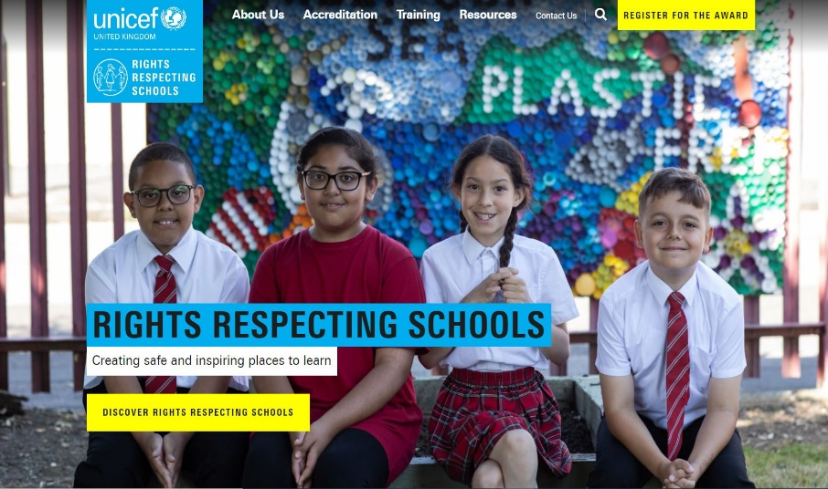
MORE INFO
RRSA WEBSITE
For more information or to download previous Article of the Week packs please visit the RRSA website by clicking on the link below.
CLICK HERE

Slide 16
THANK YOU

