Slide 1
ARTICLE OF THE WEEK
Notes:
Millah, 12, a girl with an intellectual disability, plays with her cousin, Ririnin at their home in Ungaran, Central Java. Millah is a student at Madrasah Ibtidaiyah Keji (MI Keji) in Ungaran and dreams of becoming a doctor.

Slide 2
INSTRUCTIONS
Slide 3: Guess the article
Slide 4: Introducing Article 24
Slide 5: OutRight 2022/23
Slide 6: Exploring Article 24
Slide 7: Some possible answers
Slide 8, 9 & 10: Primary activities
Slide 11, 12 & 13: Secondary activities
Slide 14: Reflection

Slide 3
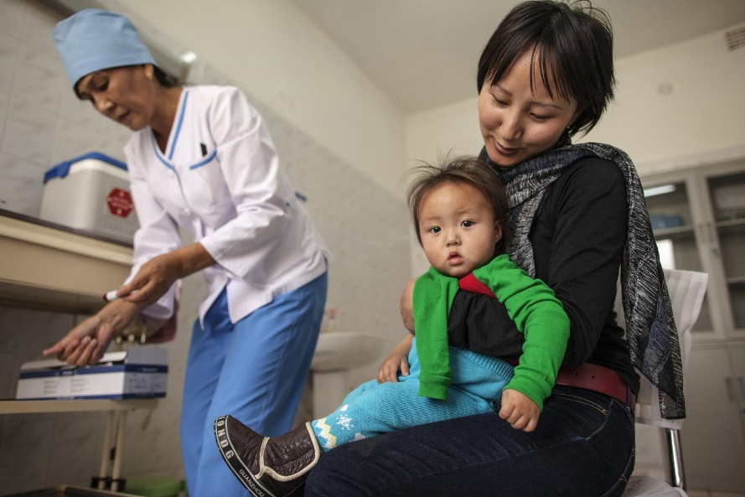
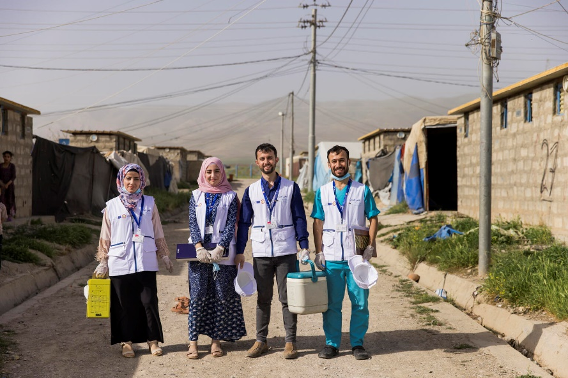
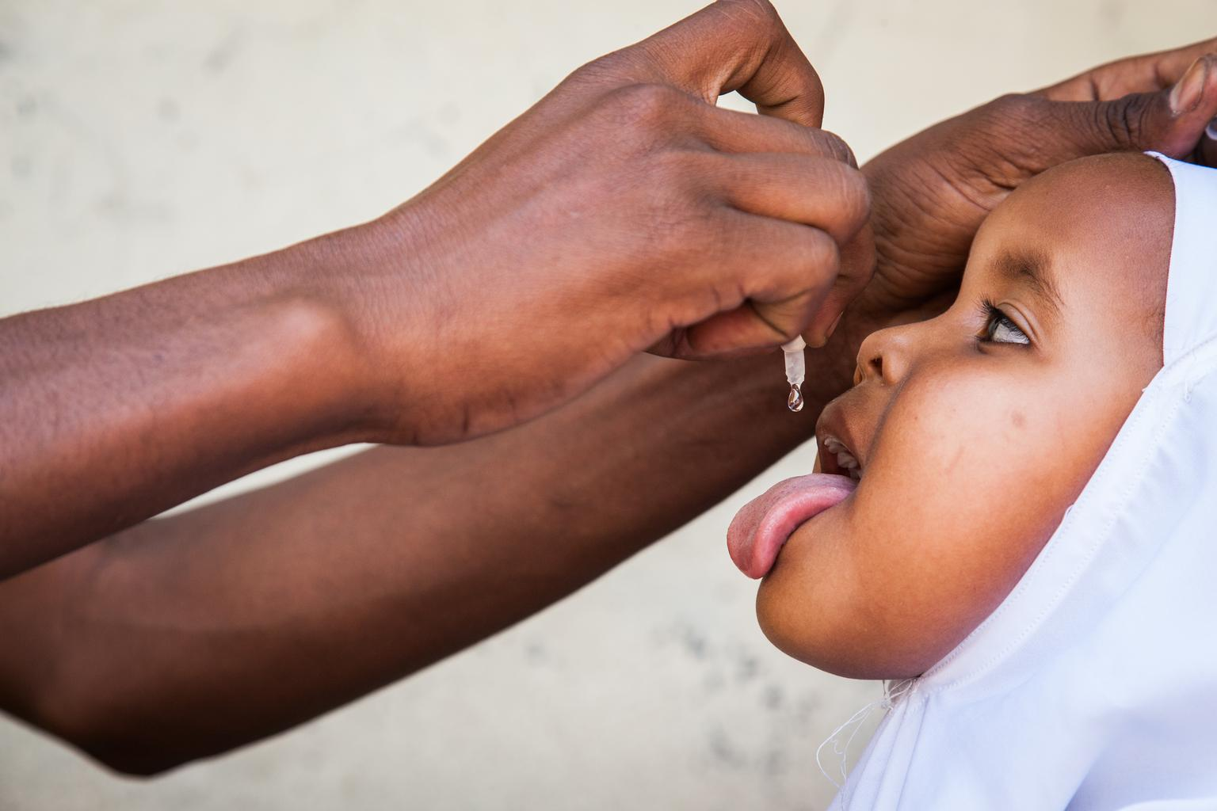
GUESS THE ARTICLE
@UNICEF/Sokol
@UNICEF/Njiokiktjien
@UNICEF/Ohanesian
These pictures provide a clue to this week’s articles.
How do these pictures help you? Can you guess how they are linked together?
Write down your thoughts or discuss with someone in your class.

Slide 4
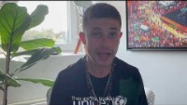
ARTICLE 24
Article 24
(health and health services)
Cel Spellman, UNICEF UK High Profile Supporter, introduces Article 24
This year’s OutRight focuses on Article 24. Watch Cel Spellman’s video and think how you might get involved. You can find out more about OutRight on the next slide.
Article 24 says: Every child has the right to the best possible health. Governments must provide good quality healthcare, clean water, nutritious food, and a clean environment and education on health and well-being so that children can stay healthy. Richer countries must help poorer countries achieve this.
We will also link to Article 13: Every child must be free to express their thoughts and opinions and to access all kinds of information, as long as it's it is within the law.
Click here to watch on YouTube

Slide 5

OUTRIGHT 2022/23
OutRight is UNICEF UK’s annual youth campaign. By signing up to this year’s campaign, you can learn about and campaign on all children’s right to the best possible health.
We all want to feel as well as possible, mentally and physically, but this isn’t possible for many children. Half of the world goes without access to the healthcare they need, so there are millions of children who can’t visit a nurse when they’re poorly or may miss out on vaccinations.
Through free learning activities, campaigning and live events, discover what we can do so that all children have their right to the best possible health fulfilled.
Sign up here.

Slide 6
EXPLORING ARTICLE 24
What and who helps you to be healthy?
Have a think and write down some answers.

Slide 7
EXPLORING ARTICLE 24
Did you think of these?
Hospitals
Doctors
Nurses
Dentists
Doctor’s surgeries
Health visitors
Pharmacists
Paramedics
Chemist
Parents, carers, family members
Schools, teachers, support staff
Getting enough sleep
A good diet
Exercise and activity
Enjoying hobbies and interests
What else did you think of?

Slide 8
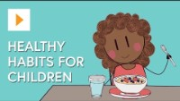

PRIMARY ACTIVITIES
You do not need to complete every activity but if you have time, you can try to complete more than one.
Watch this video on healthy habits. Think about ways that you can share some of the information, for example make a poster of ‘rainbow’ foods, or a display with as many kinds of exercise as you can think of.
Watch the doctor check-up song video. Draw an outline of a child and as a class point out and draw on all the things that the doctor looks at.
Write or draw an A-to-Z list of different ways that children can enjoy Article 24. For example, V is for Vaccinations, H is for hospitals. Compare your list with someone in your class.
Doctors have a very important job in helping us stay healthy. Watch this video then talk about different ways that doctors help people. Draw pictures or make a shared collage of people who help us to stay healthy.

Slide 9


PRIMARY ACTIVITIES 2
You do not need to complete every activity but if you have time, you can try to complete more than one.
How many other articles from the CRC can you find that link to making health systems better and stronger, and improving every child’s right to the best possible health. (CRC summary here)
Watch this video on how vaccines work and then talk to someone about what you have found out or make a poster to show how vaccines work.
Watch this video of Paddington being found at the train station. Create and colour a tag like Paddington’s and on one side write ‘Let’s look after each other’ and on the other side write some of the words from the text of Article 24. Display the tags in your classroom.
This activity is from the OutRight resources – Schools can sign up for free here.
Imagine you had a five-minute radio interview to express your views about the importance of having a good health service. What would you say? Pair up with a friend and interview one another.

Slide 10

PRIMARY ACTIVITIES 3
You do not need to complete every activity but if you have time, you can try to complete more than one.
People have different opinions and views about the healthcare they receive. Doctors, hospitals and dentists sometimes organise patient surveys. Have a class discussion to hear about different people’s opinions about and experiences of healthcare – things they liked or were pleased about as well as things that may have been difficult or worrying.
This activity links articles 13 and 24 but don’t forget to mention the right to privacy (Article 16) at the start.
Find out about an individual or organisation that has helped to change medicine, disease prevention or other aspects of healthcare. Create five top facts and share them with someone in your class.
Read these photo stories and watch the video at the end. Design and make a board game about the journey of a vaccine, perhaps like Snakes and Ladders to show the challenges as well as the positives.

Slide 11
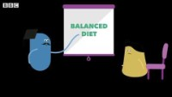
SECONDARY ACTIVITIES
You do not need to complete every activity but if you have time, you can try to complete more than one.
What does your right to the best possible health mean to you? What are the many different things you can do to be healthy? What support do you need from others to help you achieve this? Write an article or create a short video about this and share with your class mates whilst keeping in mind Article 16 and the right to privacy.
Write or draw an A-to-Z list of different ways that children and young people can enjoy Article 24. For example, V is for Vaccinations, H is for hospitals. Compare your list with someone in your class.
Find out about an individual or organisation that has helped to change medicine, disease prevention or other aspects of healthcare. Create five top facts and share them with someone in your class.
Watch this BBC Bitesize video about a healthy lifestyle. Discuss what could help you to build healthy habits. Talk to someone else in your class and share your ideas – it makes it more likely to happen!

Slide 12
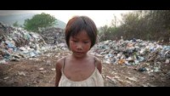
SECONDARY ACTIVITIES 2
You do not need to complete every activity but if you have time, you can try to complete more than one.
Watch this UNICEF video about the right to a clean environment. Now watch again with a pen and paper and list the issues shown in the video. Work in a groups and plan how you can take action to raise awareness of one or more of these issues.
Create a quiz full of health facts to raise awareness of access to the best possible health locally and globally. Discuss an action you can take to help improve access to one of these.
Find out some facts about numbers in health and social care. This charity website is a great place to start. What are the risks if we don’t have enough people working in health services? What other rights might be affected? With your friends think of a way to raise awareness in your community.
Articles 24 and 28 say that richer countries must help poorer countries to ensure that health and education can be accessed by all children. Do some research to find out how organisations like UNICEF help governments to achieve this. Report back to your class.

Slide 13
SECONDARY ACTIVITIES 3
You do not need to complete every activity but if you have time, you can try to complete more than one.
Article 24 states that the government should provide education on health and wellbeing. Is there an aspect of health and wellbeing that you would like to learn more about at school? How might you speak with school leaders about this and create a change?
Read these photo stories and watch the video at the end. Identify some of the obstacles that prevent children and young people accessing the healthcare they need. What might be some risks to children and young people if they can’t access the care they need? This activity is from the OutRight resources – Schools can sign up for free up here.
People have different opinions and views about the healthcare they receive. Doctors, hospitals and dentists sometimes organise patient surveys. Have a class discussion to hear about different people’s opinions about and experiences of healthcare – things they liked or were pleased about as well as things that may have been difficult or worrying.
This activity links articles 13 and 24 but don’t forget to mention the right to privacy (Article 16) at the start.
Staying healthy mentally is important for everyone, the same way that staying physically healthy is important for everyone. About one in four people in the UK will experience a mental health problem each year. Find out about the support from organisations such as Young Minds and NSPCC.

Slide 14
REFLECTION
Find somewhere quiet to sit and reflect on these three questions:
When you think of healthcare that you have had, what are you really grateful for?
What more could you do to keep yourself mentally and physically healthy?
How could others help with your right to the best possible health. And what might you do for them?

Slide 15

MORE INFO
RRSA WEBSITE
For more information or to download previous Article of the Week packs please visit the RRSA website by clicking on the link below.
CLICK HERE

Slide 16
THANK YOU

