Slide 1
ARTICLE OF THE WEEK
Notes:
Image: Sidonie, 10, in her classroom at Ecole Primaire Kintambo 3 located in Kinshasa, DR Congo, on September 5, 2022.

Slide 2
INSTRUCTIONS
Slide 3: Introducing Black History Month
Slide 4: Linked UNCRC articles
Slide 5: Exploring Black History Month
Slide 6: Some possible answers
Slide 7, 8 & 9: Primary activities
Slide 10, 11 & 12: Secondary activities
Slide 13: Reflection

Slide 3
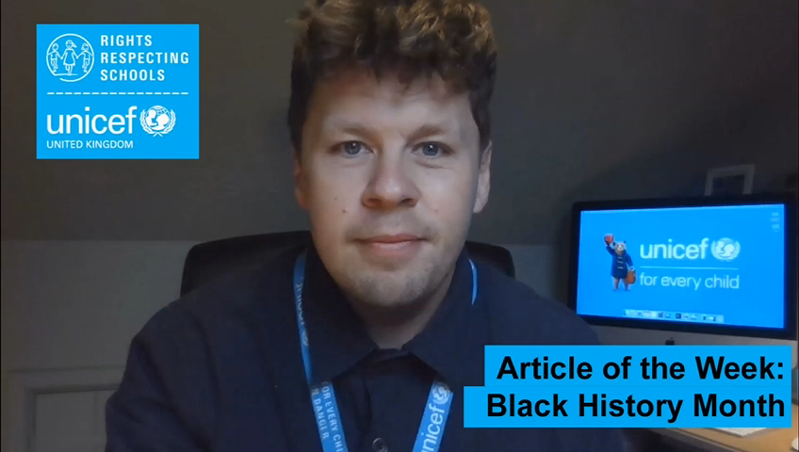
INTRODUCING BLACK HISTORY MONTH
Black History Month
Stuart Whiffin, RRSA Professional Adviser, introduces Black History Month
Black History Month takes place in October every year and is a celebration of key figures and events in Black history. Having begun in the USA, it has been celebrated in the UK since 1987, with the emphasis on celebrating particularly the history and contributions to society of people with an African or Caribbean heritage.
There is a different theme every year, for example in 2021 the theme ‘Proud to Be’, aimed to recognise the achievements and contributions that Black people make to the UK every day. The 2022 theme, Time for Change: Action Not Words highlights the importance of being an ally and coming together around shared common goals to achieve a better world for everyone.
Click here to watch on YouTube

Slide 4


LINKED UNCRC ARTICLES
The activities in this pack about Black History Month link with many articles of the CRC but two particular rights stand out when we explore this theme
Article 2 (non-discrimination)
The Convention applies to every child without discrimination, whatever their ethnicity, gender, religion, language, abilities or any other status, whatever they think or say, whatever their family background.
Article 30 (children from minority or indigenous groups)
Every child has the right to learn and use the language, customs and religion of their family, whether or not these are shared by the majority of the people in the country where they live.

Slide 5
EXPLORING BLACK HISTORY MONTH
Why do you think celebrating Black History Month is important?
Have a think and write down some answers.

Slide 6
EXPLORING BLACK HISTORY MONTH
Did you think of these?
To recognise the contribution and achievements of those with African and Caribbean heritage throughout history.
To ensure that we hear a diverse range of stories when considering the past.
To celebrate people’s heritage and cultures.
Because all communities, including schools, should encourage respect for everyone and celebrate diversity and inclusion.
To think about how we can make the world a more equal place where everyone’s rights are respected.
To learn how to challenge negative stereotypes.
To ensure that there is time and space for people to discuss more recent events and issues such as Black Lives Matter, the treatment of the Windrush generation and the death of George Floyd.
Because no one should be treated differently because of who they are.
To learn about racism and its effects.
To support people to recognise and challenge discrimination.
What else did you think of?

Slide 7

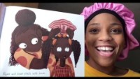
PRIMARY ACTIVITIES
You do not need to complete every activity but if you have time, you can try to complete more than one.
Read the story Elmer the Elephant, you can also watch it here. Elmer didn’t feel that he wanted to be the same as the other elephants. Think of ways that we can celebrate our differences like the elephants do on ‘Elmer Day’ – talk about your ideas with an adult.
Everyone is special and important! What is the best thing about being you? Create a classroom display that reflects what you are ‘Proud to Be’. Link this to relevant articles from the CRC.
Imagine a world with zero discrimination. Work with your friends and discuss how this would feel for everybody. Describe the experiences and feeling, then use your ideas to create a poem, a song or a piece of art called “Article 2 – Sorted!!”
Enjoy story time by choosing some books to share by some new Black British authors such as My Hair by Hannah Lee which was nominated for the 2020 BookTrust Storytime Prize.

Slide 8
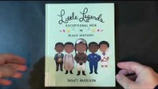
PRIMARY ACTIVITIES 2
You do not need to complete every activity but if you have time, you can try to complete more than one.
Watch these children talking about Black history with their parents. Who could you have a conversation with about Black history? What could you tell them about what Black history Month is and why it is important?
As a class, chose some people to read about from the Little Leaders books – Exceptional Men in Black History and Bold Women in Black History, or from the Little People, Big Dreams series. Discuss their achievements and how these link to rights in the CRC. You could then choose someone who inspires you and write a short fact sheet about them.
Carry out an audit of your school library to see how diverse the range of books is. Does it have books by a range of authors? Are there books with a wide range of characters? How could you work together as a school community to make sure that everyone is represented by the books in the library?
Look up the theme of this year’s Black History Month and explore the resources. Find a way of promoting the main messages in your school. You could do this through a display, an assembly, a newsletter article or whatever you think will work.

Slide 9
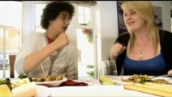
PRIMARY ACTIVITIES 3
You do not need to complete every activity but if you have time, you can try to complete more than one.
Watch this video of children talking about their experience of racism in UK. How did this make you feel? Take some time as a class to reflect on this and discuss the issues the children raise. Make a pledge to stand up against racism.
Black History Month has a focus on people of African and Caribbean heritage. Find out what special times, celebrations, and events there are to celebrate other heritage and cultures from which people come. Create a calendar to show all of these across a year.
Read the poem ‘The British’ by Benjamin Zephaniah or watch it performed here. Write your own class version for what makes up your class or your school. Or choose another poem from here.
Watch this video about the Bristol Bus Boycotts. Discuss why this was an important moment in British History.

Slide 10

SECONDARY ACTIVITIES
You do not need to complete every activity but if you have time, you can try to complete more than one.
Research the term ‘unconscious bias’. Feedback what you find out and have a class discussion about how this relates to Article 2 (non-discrimination).
Watch this video about stereotypes of African men in Hollywood films. In what ways do you think Black people are stereotyped in British society? How can we challenge these stereotypes?
Look up the theme of this year’s Black History Month and explore the resources. Find a way of promoting the main messages in your school. You could do this through a display, an assembly, a newsletter article or whatever you think will work.
Read more about Black History Month and why it is important on BBC website. How does celebrating BHM link to children’s rights? Make a pledge to tell someone about the importance of BHM either in person or through social media.

Slide 11
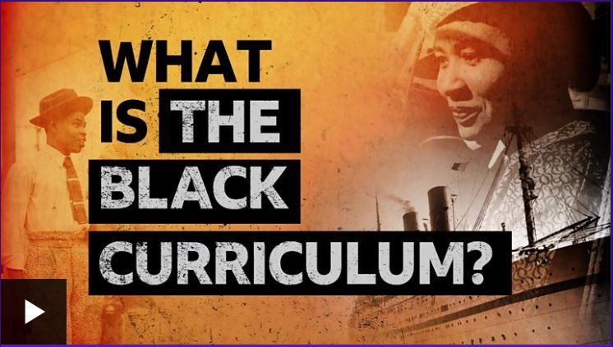
SECONDARY ACTIVITIES 2
You do not need to complete every activity but if you have time, you can try to complete more than one.
Carry out some research using blackhistorymonth.org.uk/section/bhm-firsts or theblackcurriculum.com/freelearning to find out more about Great Black Britons. How do their achievements link to rights? Find a way of sharing what you have learnt.
Read over the wording of articles 2 and 30 and check out any vocabulary you are not sure about. Use your creativity to write, draw, sing (or express in any way you like) a world where these two rights are fully achieved for all.
There have been calls to encourage schools to teach about Black history all year round rather than just during Black History Month. Watch this video to find out more about the Black Curriculum. Have a discussion about whether your school could do more to teach Black history all year round.
In your tutor group or in an English class, choose to read a book such as Noughts and Crosses by Malorie Blackman, The Hate you Give by Angie Thomas or Journey to Jo’burg by Beverley Naidoo. Discuss the issues that your chosen book raises and try to link these to Black History Month and relevant articles from the CRC.

Slide 12
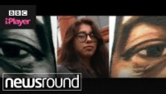
SECONDARY ACTIVITIES 3
You do not need to complete every activity but if you have time, you can try to complete more than one.
There are many statues around the world to commemorate people who have made a difference in some way. How many statues of black people do you think there are in the UK? Read this article from the BBC to find out more about this. Explore and discuss which black people have made a positive contribution in your local area – How might their achievement best be commemorated?
How are different cultures represented and celebrated in your school – through the environment and the curriculum? Undertake a survey to review this and use the results to make changes.
Black British artist Tam Joseph created this painting, School Report, in 1983. It shows a young black boy on his journey through the school system. Have a look at the painting. Think about it and then discuss in class what the artist was trying to say. Find out about other influential Black British artists.
Watch this video about a young woman who started a 'Black Lives Matter' protest in Manchester. What could you do in your everyday life to challenge racism?

Slide 13
REFLECTION
Take a little time to think…find somewhere quiet and give yourself some space…
Spend some time thinking again about what makes you proud to be the person you are.
How can you regularly remind yourself of these things?
What can you say to others to help them feel proud of themselves and who they are?
Think about what you could do if you ever hear or see racism at school or in your community.
How can you challenge this and be an ally to others?

Slide 14

MORE INFO
RRSA WEBSITE
For more information or to download previous Article of the Week packs please visit the RRSA website by clicking on the link below.
CLICK HERE

Slide 15
THANK YOU

